Slide 1
Search Marketing: SEO and SEM SMM 9340
with Suse Barnes
Marketing Program SF State CEL

Slide 2
Notes:
Welcome to the world of search and social media

Slide 3
Introductions

Slide 4
Introductions
A bit about me and a lot about YOU
Please tell us
your name,
your company,
what you want to be when you grow up,
what you hope to get out of this class
how much know about SEO and SMO. Thank you!

Slide 5
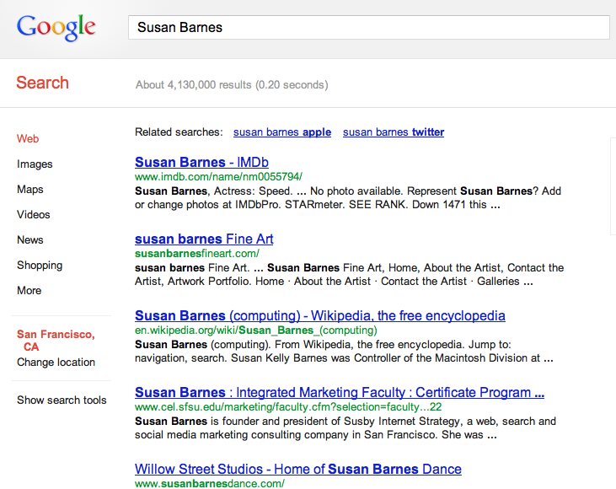
Introductions
January 2013
Notes:
4,130,000 (4.1 million)

Slide 6
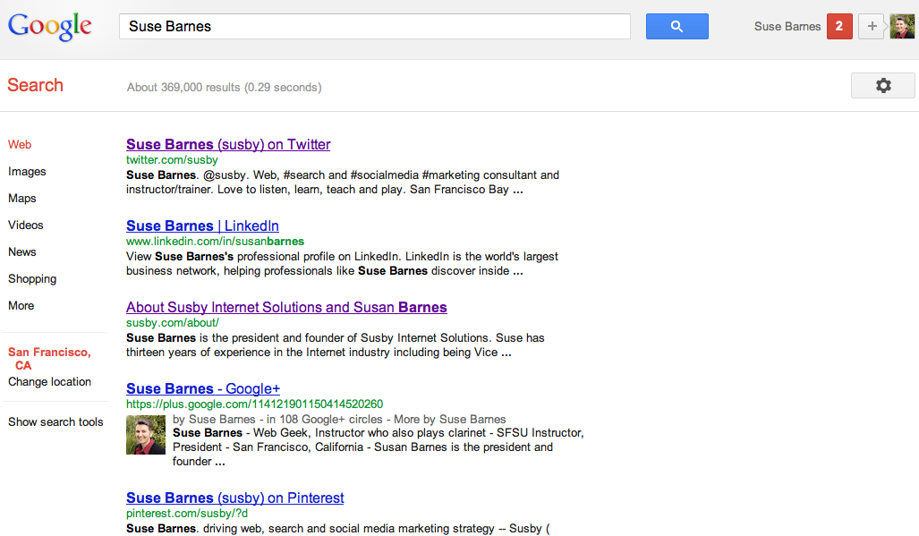
Suse Barnes
January 2013
Notes:
369,000

Slide 7
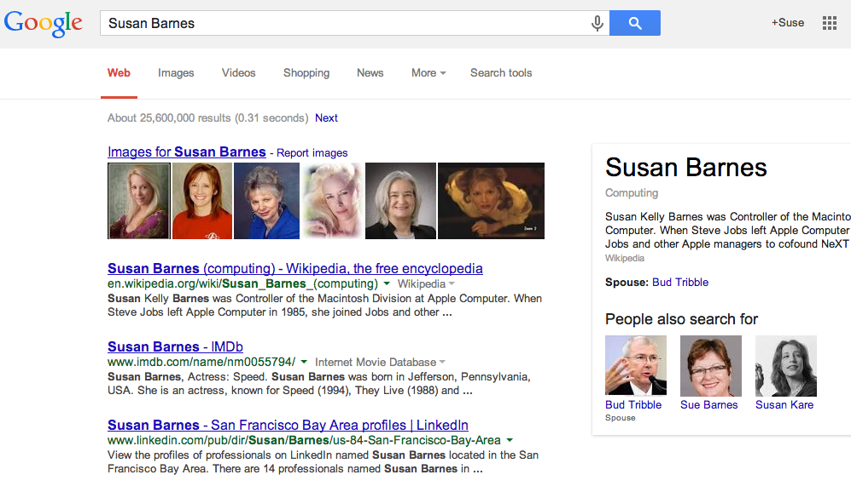
January 2014 2013
Notes:
25.6 million

Slide 8
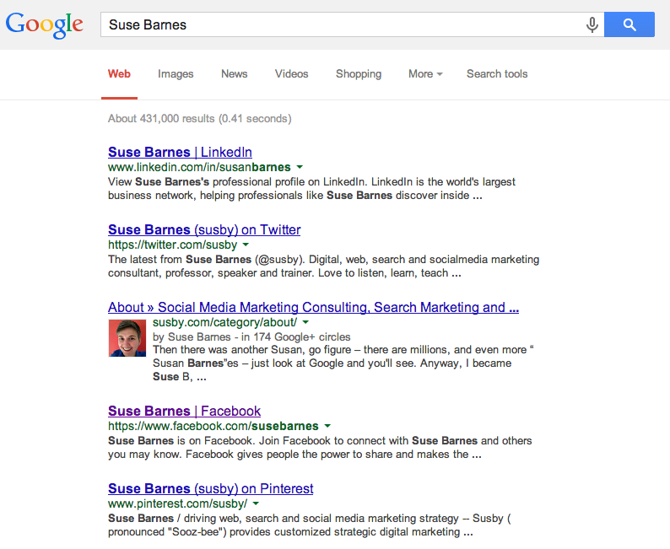
January 2014
Notes:
431,000

Slide 9
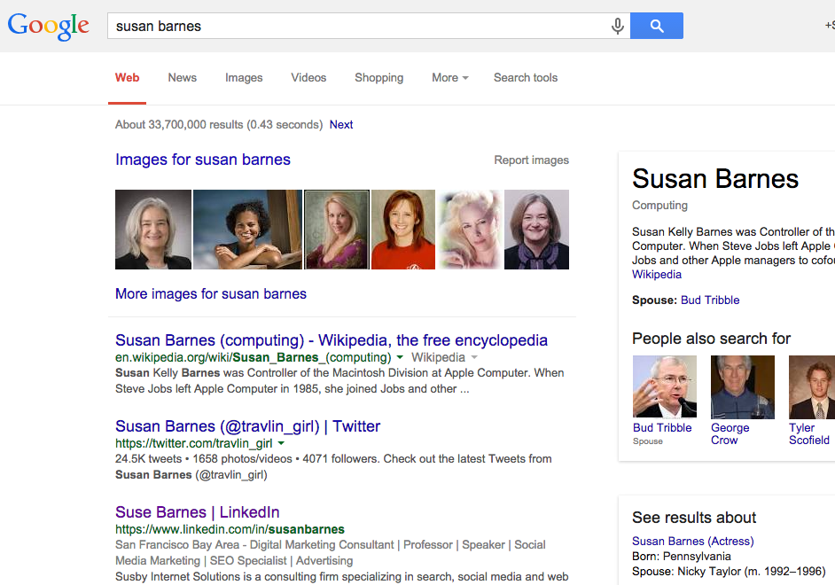
January 2015
Notes:
33.7 million

Slide 10
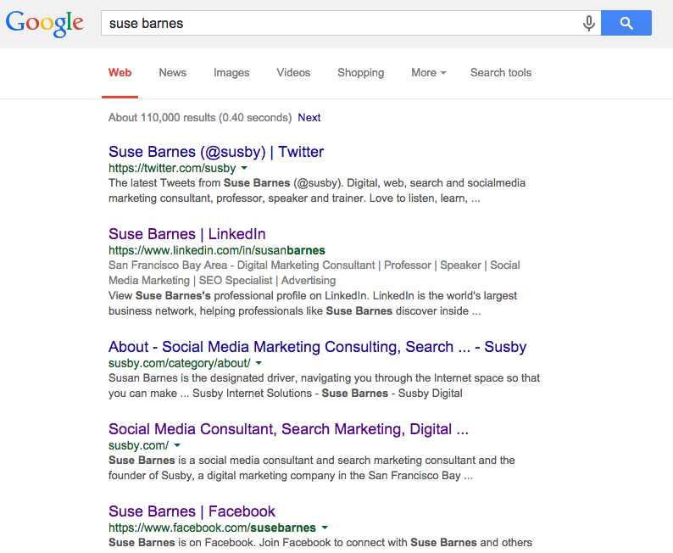
January 2015
Notes:
110,000

Slide 11
Search Results Competition
Number of Search Results
Search Term | Jan-13 | Jan-14 | Jan-15 | Jan-16
Susan Barnes | 4,130,000 | 26,600,000 | 33,700,000 | 31,900,000
Suse Barnes | 369,000 | 431,000 | 110,000 | 91,500
Who’s winning?

Slide 12
How do you appear in search?
Your name

Slide 13
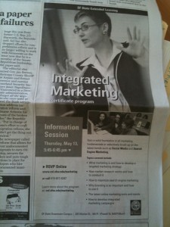

Slide 14
Instructor/Professor

Slide 15
Listen

Slide 16
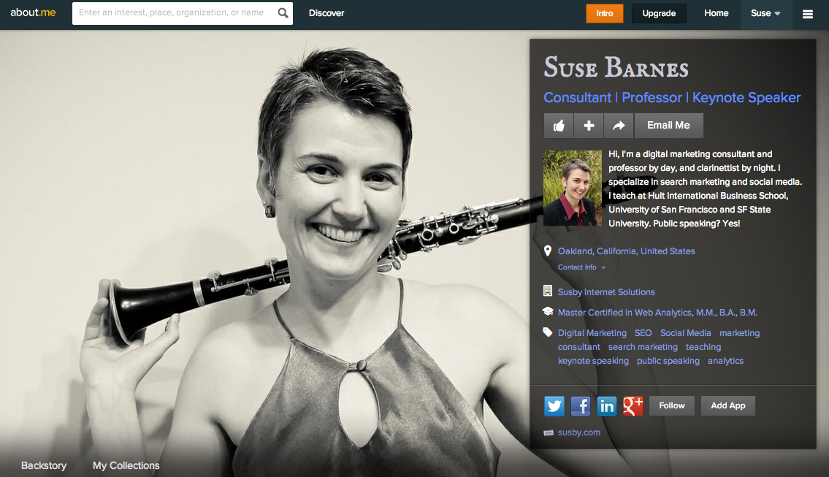
http://about.me/susebarnes

Slide 18
Class 1

Slide 19
What We’ll Cover in this Class
SEO
SEM
SMO
Tools and Tricks
Checklists
Strategy and Best Practices
Summary and Next Steps

Slide 20
Two Tuesdays and a Saturday
This course is short. Make the most of it.
Setup, SEO, Blog, Analytics, SMO, Site Clinics, Paid Search, AdWords, Questions, Strategy and Best Practices, more resources…

Slide 21
Class 1 Agenda
Setup
SEO
Blog Homework

Slide 22
1. Setup: What do you need for this class?
Access to a website you can analyze
Preferably with social media accounts for the same site already in place
Don’t have one? No problem! You may use the class blog at http://dgtl.us to practice with and
your assignment is to post one blog post whether you have a site or not.

Slide 23
Class Sites
Course Materials:
http://www.susby.com/sfsu/
Class Blog: http://dgtl.us

Slide 24
Setup
Make sure we all have:
Google Account
Google Analytics (or use the class account)
Google AdWords (or use the class account)
Google Plus
Facebook Account
LinkedIn Account
Twitter Account
If you don’t have all of these, your homework is to set them all up.

Slide 25
Why do we need all of these?
1. Search is primarily
2. Social signals help Google to decide if your website, web-page, or blog post is worth ranking.

Slide 26
What is a search ranking?
Demonstration: What should we search for on Google?
[Who wants to volunteer a keyword search?]

Slide 27
Notes:
Let’s get started. This slide is just to show we are starting.

Slide 28
SEO
What is SEO?
What is an SEO?
What does an SEO do?
Keywords
Placement
Links
Is there an SEO in the house?
Link Building
Tools
Notes:
Site clinic

Slide 29
What do you do when you are looking for information?

Slide 30
What do you do when you are looking for information?

Slide 31
How do you choose which results to click on?

Slide 32
Which Search Result gets your Click?
The most relevant
The most recent
The most authoritative
The most keywords

Slide 33
How does Google Decide what search results to give you?
The most relevant (content and keywords)
The most recent (fresh is best)
The most authoritative (how many inbound links and the quality of those links)
The most networked (social signals)

Slide 34
How do we make a web site findable?
To be findable, your site must have
Search Engine Friendly Content
Human Friendly Content
Keywords
Links
A Reason to Share and Return
Social Signals

Slide 35
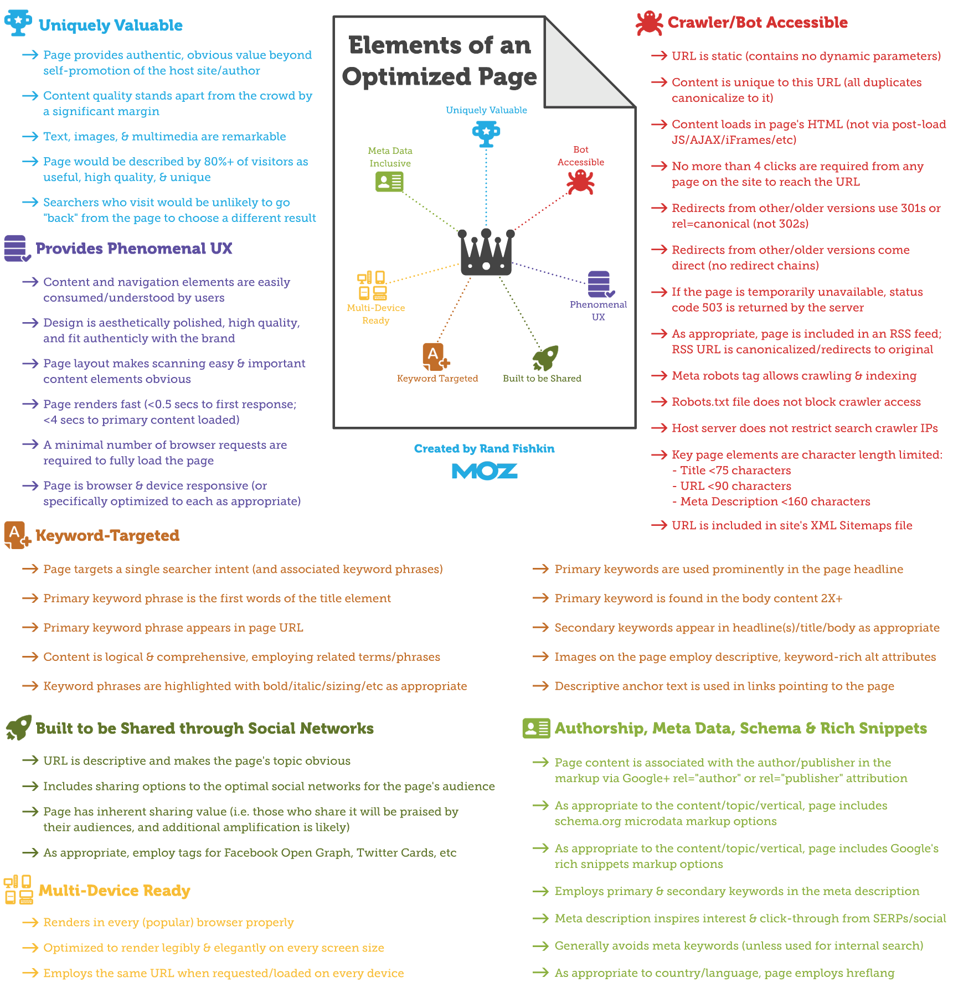
See:
http://moz.com/blog/visual-guide-to-keyword-targeting-onpage-optimization

Slide 36
But First: What is Search Engine Marketing?
Even more first: What is Marketing?
Mar-ket-ing the total of activities involved in the transfer of goods from the producer or seller to the consumer or buyer, including advertising, shipping, storing, and selling.

Slide 37
What is Search Engine Marketing?
Using search engines to promote your product or service online.
A potential customer goes online and searches for your product.
There are two possible results:
They find you. ☺
They don’t find you. ☹

Slide 38
So how do you get found?
What begins with C?
What begins with a K?

Slide 39
What is Search Engine Marketing?
If you are not on the first page of search results, you are unlikely to be found.
There are two ways to be found:
Organic (“FREE”) listings
Sponsored listings (Paid search, PPC or Pay Per Click)

Slide 40
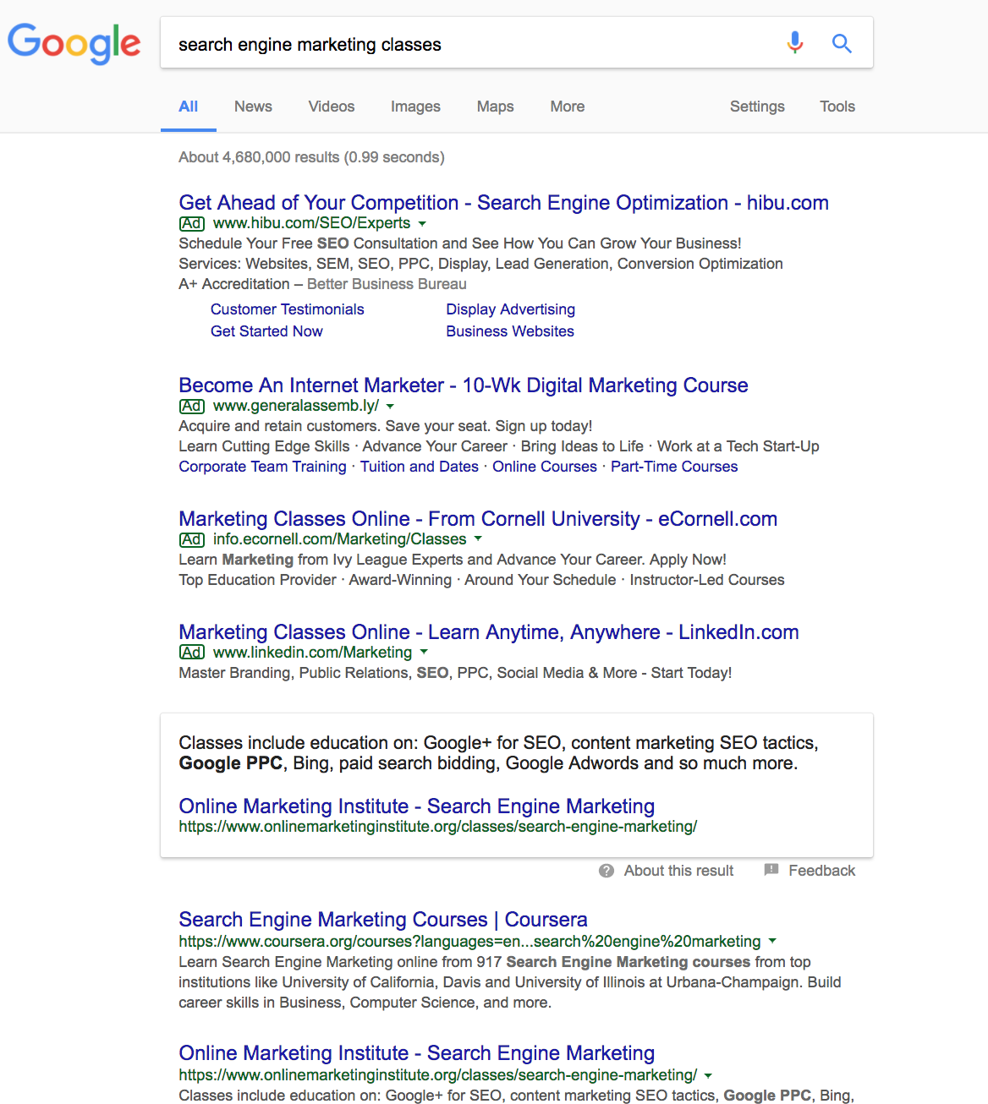
Ads =
Sponsored
Paid listings
Pay-per-click (PPC)
Cost per click (CPC)
AdWords
Paid search
Free or Organic listings start here

Slide 41
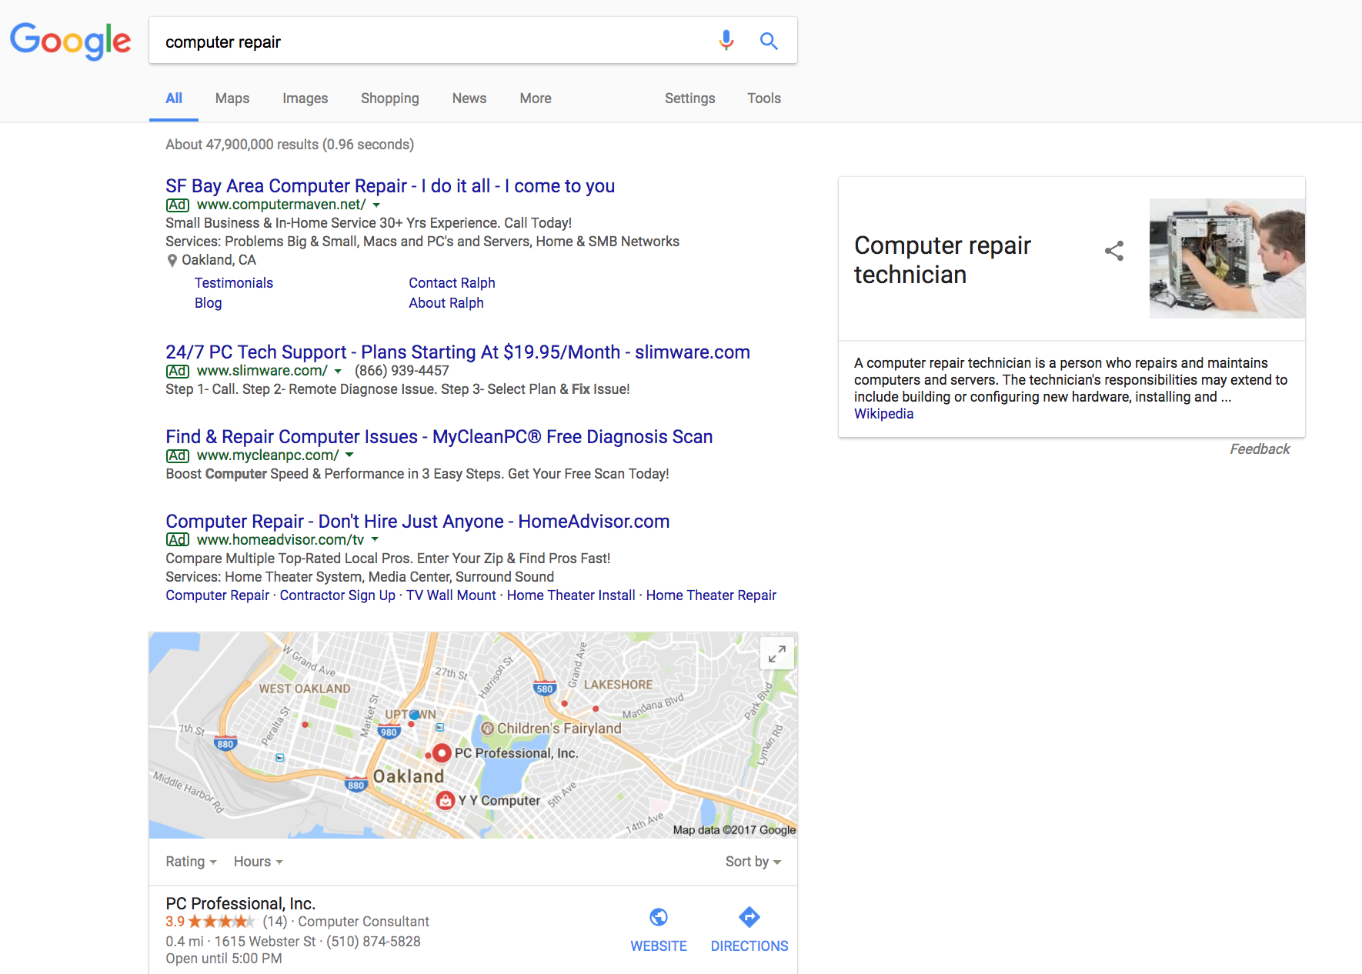
When logged into Google, it knows your
Location.
Notes:
This was a search from Oakland. If you search from San Francisco, you’ll see different results.
Sites with Google+ and more reviews get better local listings and more clicks, because they just look more appealing.

Slide 42
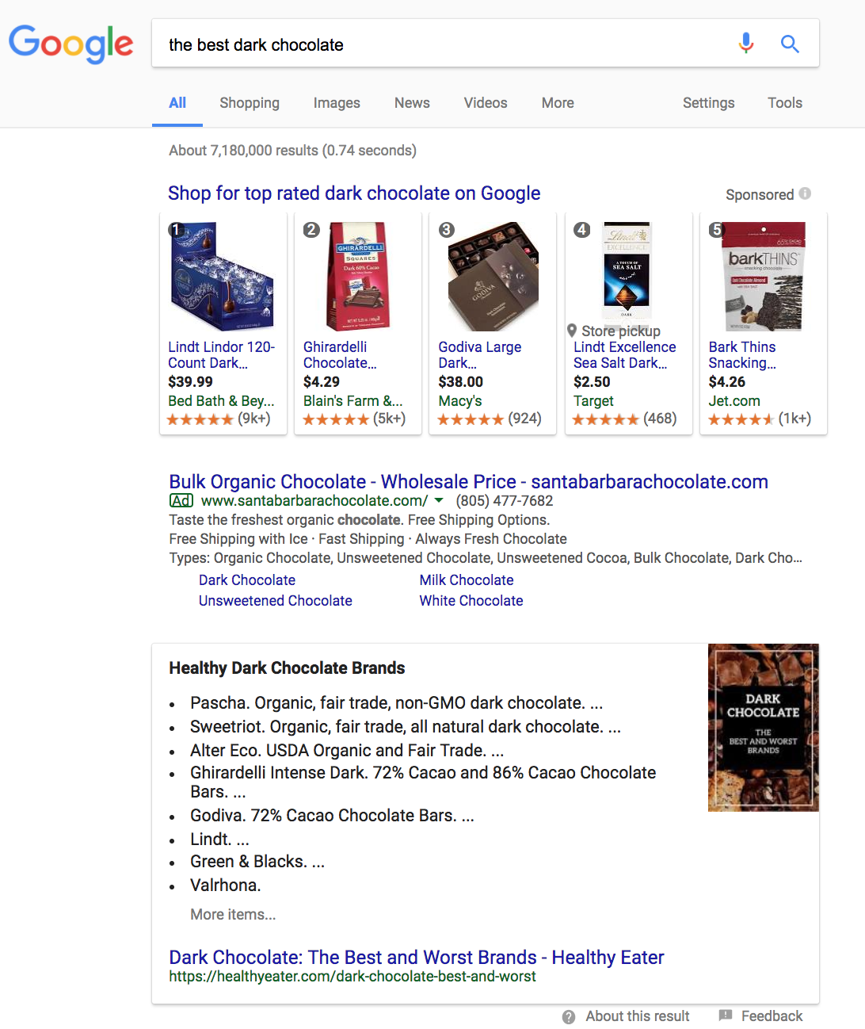
What is this?
Notes:
Rank Zero

Slide 43
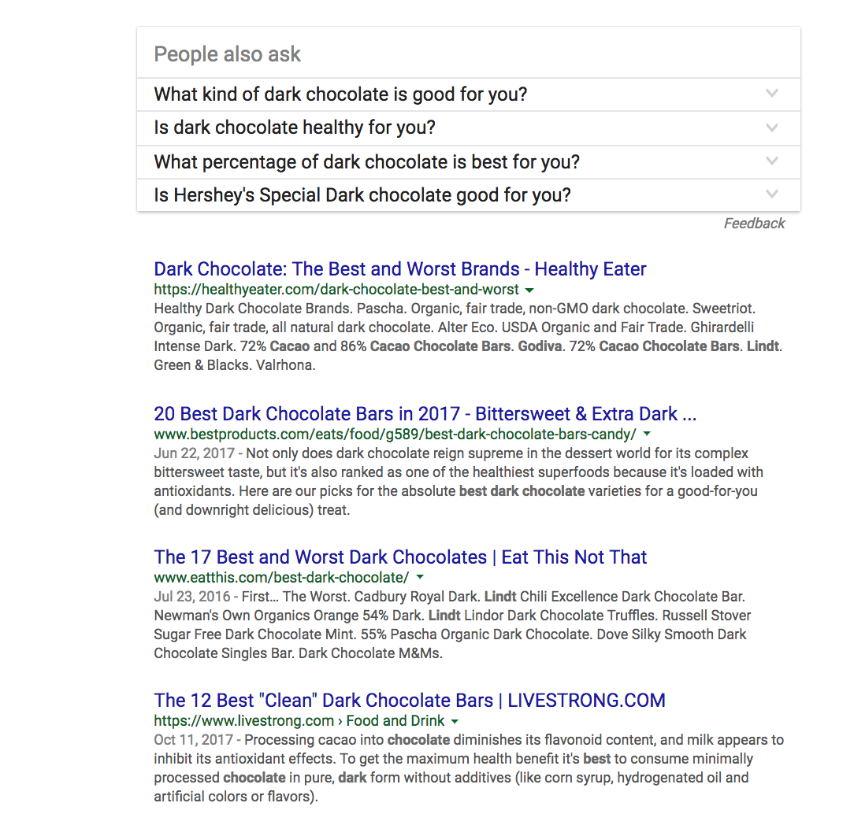
Why are these showing up # 1 and # 2?
Notes:
Try to determine why one listing is ranking higher than another. This is usually the result of PageRank, number of inbound links, keywords used in the title, description, headings, links and body content.

Slide 44
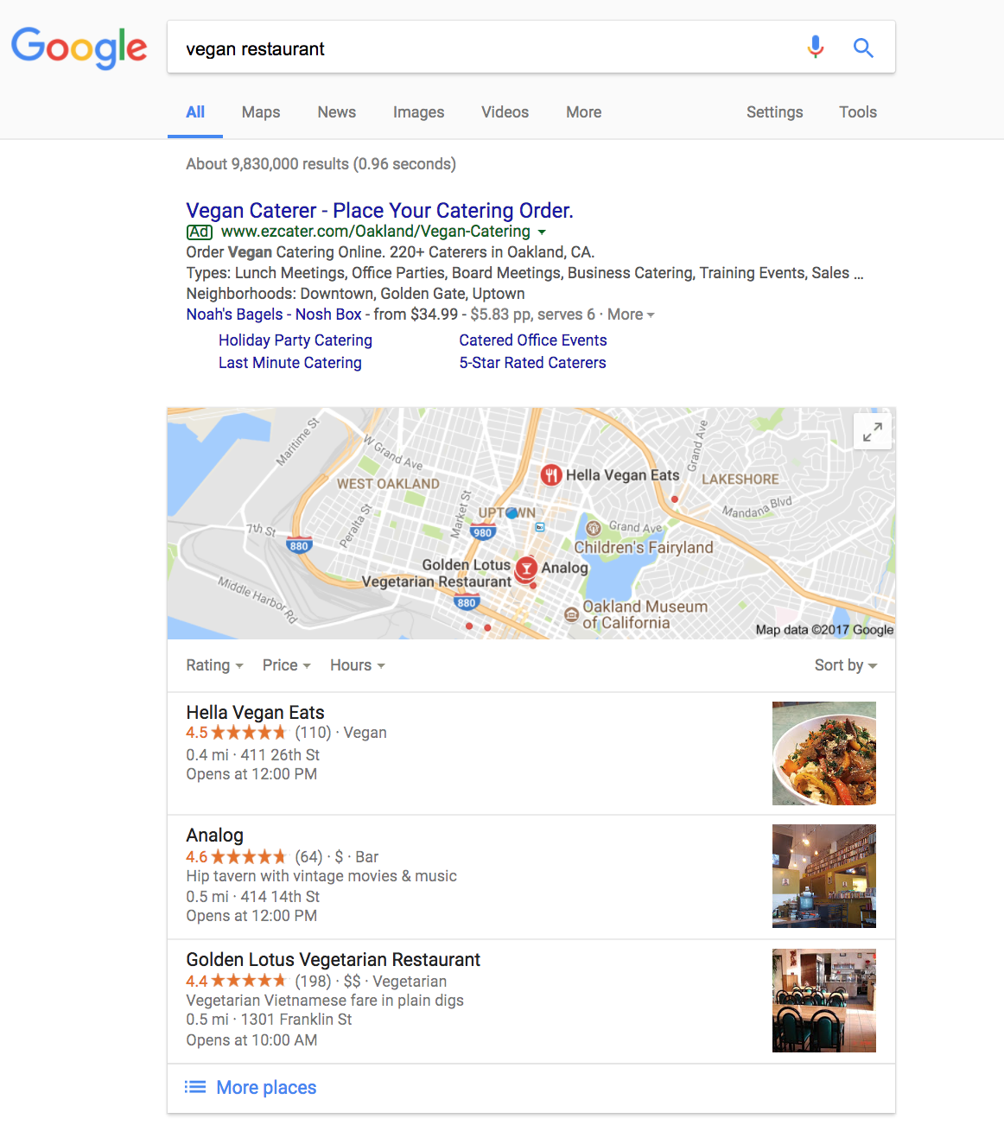
Few ads.
Can you figure out how a restaurant appears at the top of the search results?

Slide 45
What is SEO?
For Organic “Free” listing placement you need SEO aka Search Engine Optimization.
SEO is the act of carefully designing and coding your web site so that it is very friendly to search engines.
How do you do that?

Slide 46
What is SEO?
Remember that search engines are spiders and then ask yourself:
What do spiders like?
Fresh food (fresh content)
Webs (link love)
Quality (links and content)

Slide 47
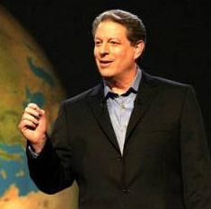
What is SEO?
What makes up a number one ranking on a search engine results page?
Each engine has a different algorithm
Al-go-rithm
a set of rules for solving a problem in a finite number of steps, as for finding the greatest common divisor.

Slide 48
What is SEO?
For search engines the algorithm takes into consideration:
The number of keywords in the content
Where the keywords display, are they in the title, meta data, hyperlinks, headings, alt tags?
What is the keyword relevancy?
How popular is the website? I.e. Link Popularity or PageRank. How many inbound links are there?
Is the site readable by a search engine AND a human?
Does the site allow easy indexing?
How often is the site referenced in social media?
How popular is the main author of the site?

Slide 49
How well is your site optimized?
For a quick understanding of where you are starting from before optimizing a site, look at http://marketinggrader.com http://www.spyfu.com http://www.semrush.com http://seoquake.com http://www.similarweb.com http://www.opensiteexplorer.org
You will get a grade for your site and some pointers on how to improve that grade. Some things you’ll be able to do by yourself and other things you’ll want to hire a professional to help you with.

Slide 50
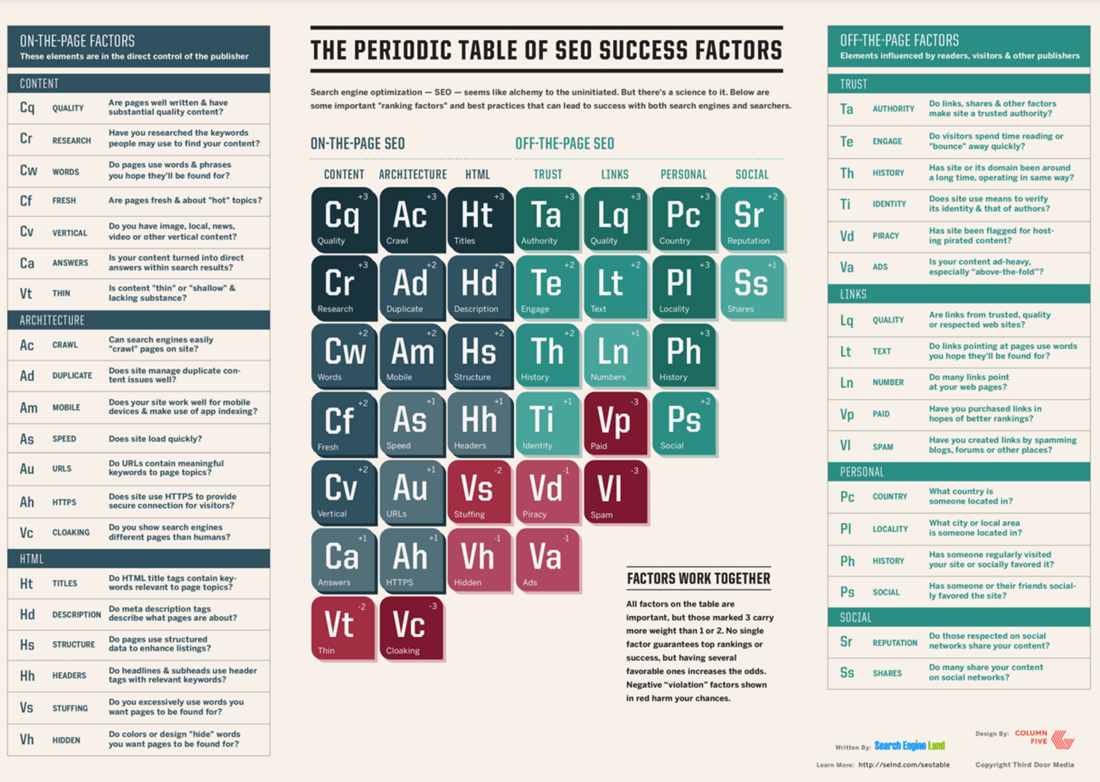
http://searchengineland.com/seotable
Notes:
http://searchengineland.com/seotable

Slide 51
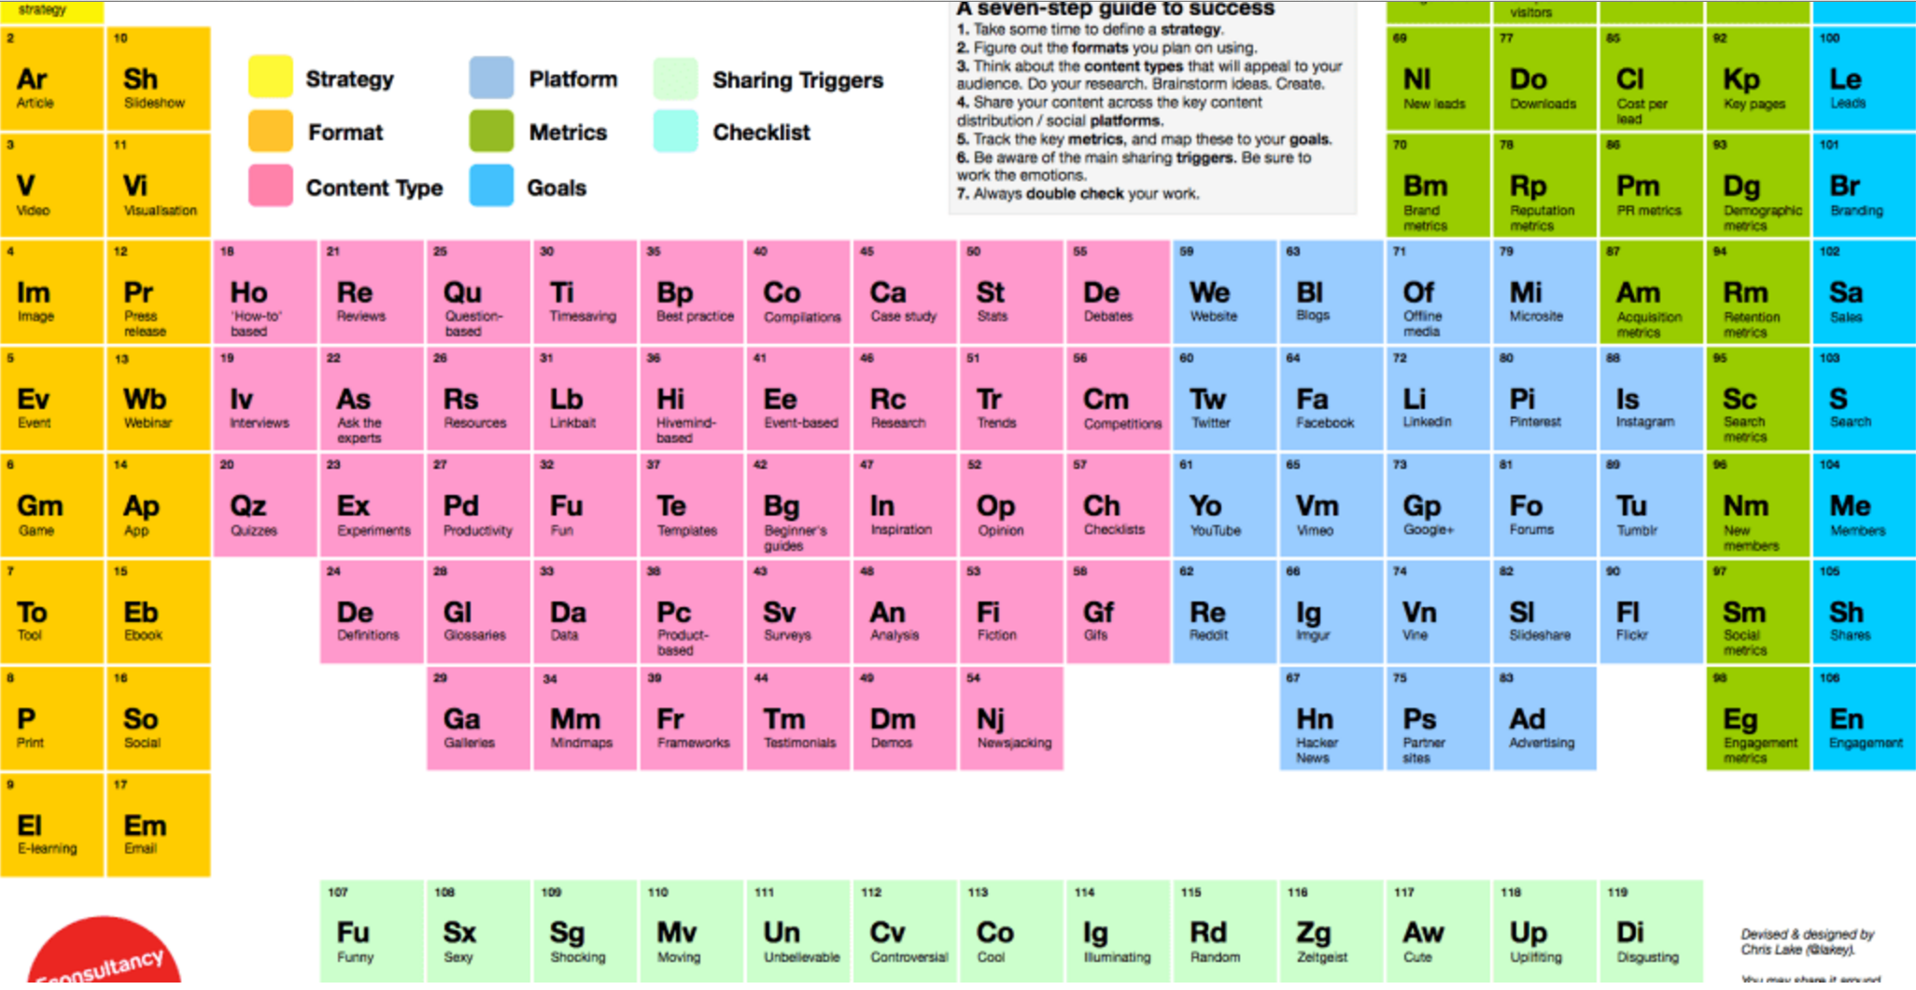
https://www.marketingtechblog.com/the-periodic-table-of-content-marketing/
Notes:
https://www.marketingtechblog.com/the-periodic-table-of-content-marketing/

Slide 52
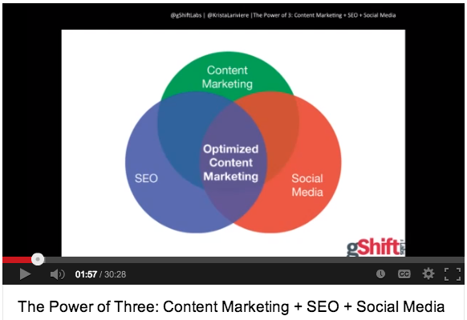
Homework Watching
http://www.youtube.com/watch?v=1v7PVF4g7Nk

Slide 53
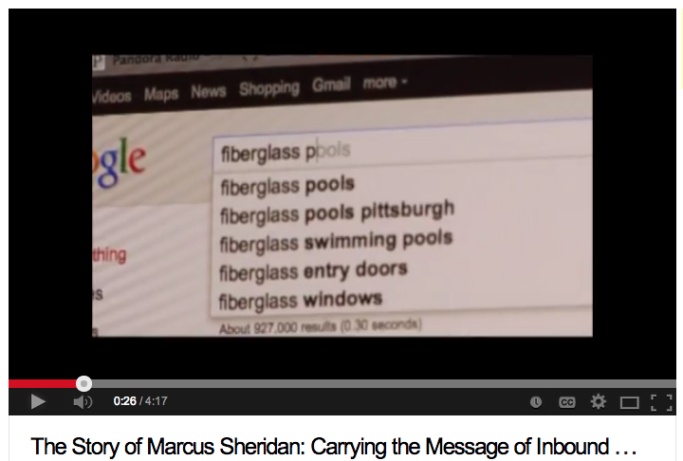
Homework Watching
http://www.youtube.com/watch?v=0sv2tLYE0R0

Slide 54
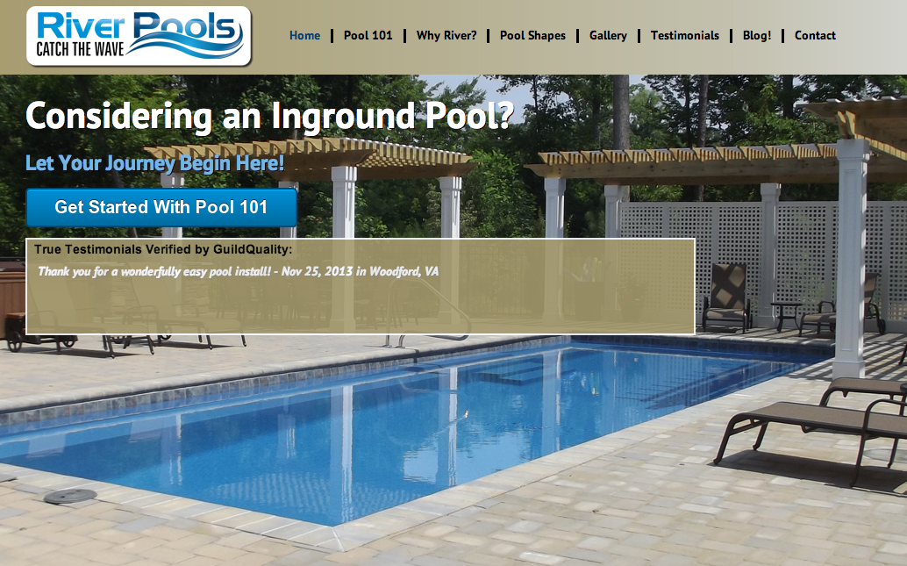
Notes:
https://conversationprism.com/

Slide 55
More Class 1
Recap of Class 1
More on SEO
Link Building
Touch on Social and Content Marketing
Wordpress Plugins

Slide 56
Which Search Engine Should You Focus On?

Slide 57
Which Search Engine Should You Focus On?
Notes:
Switch out Live Search with Bing!

Slide 58
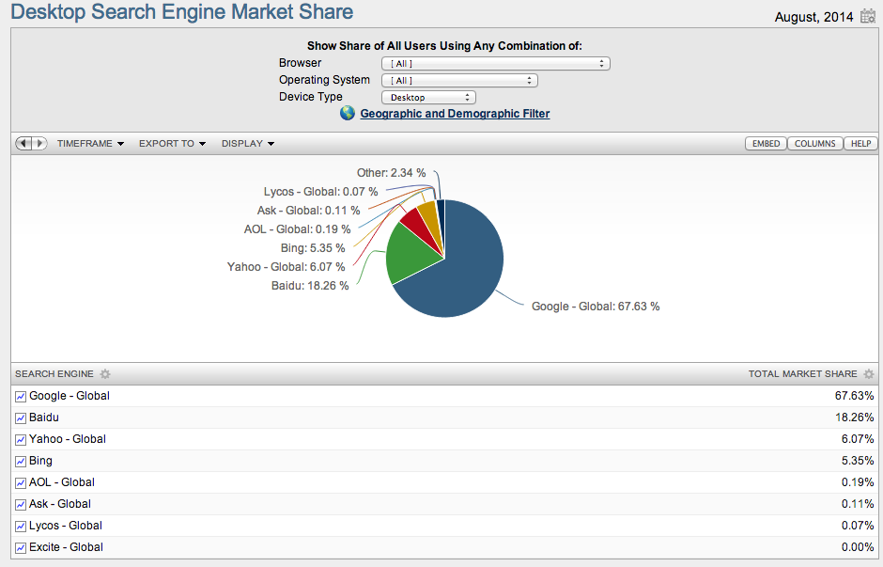
Source: http://www.netmarketshare.com/search-engine-market-share.aspx?qprid=4&qpcustomd=0

Slide 59
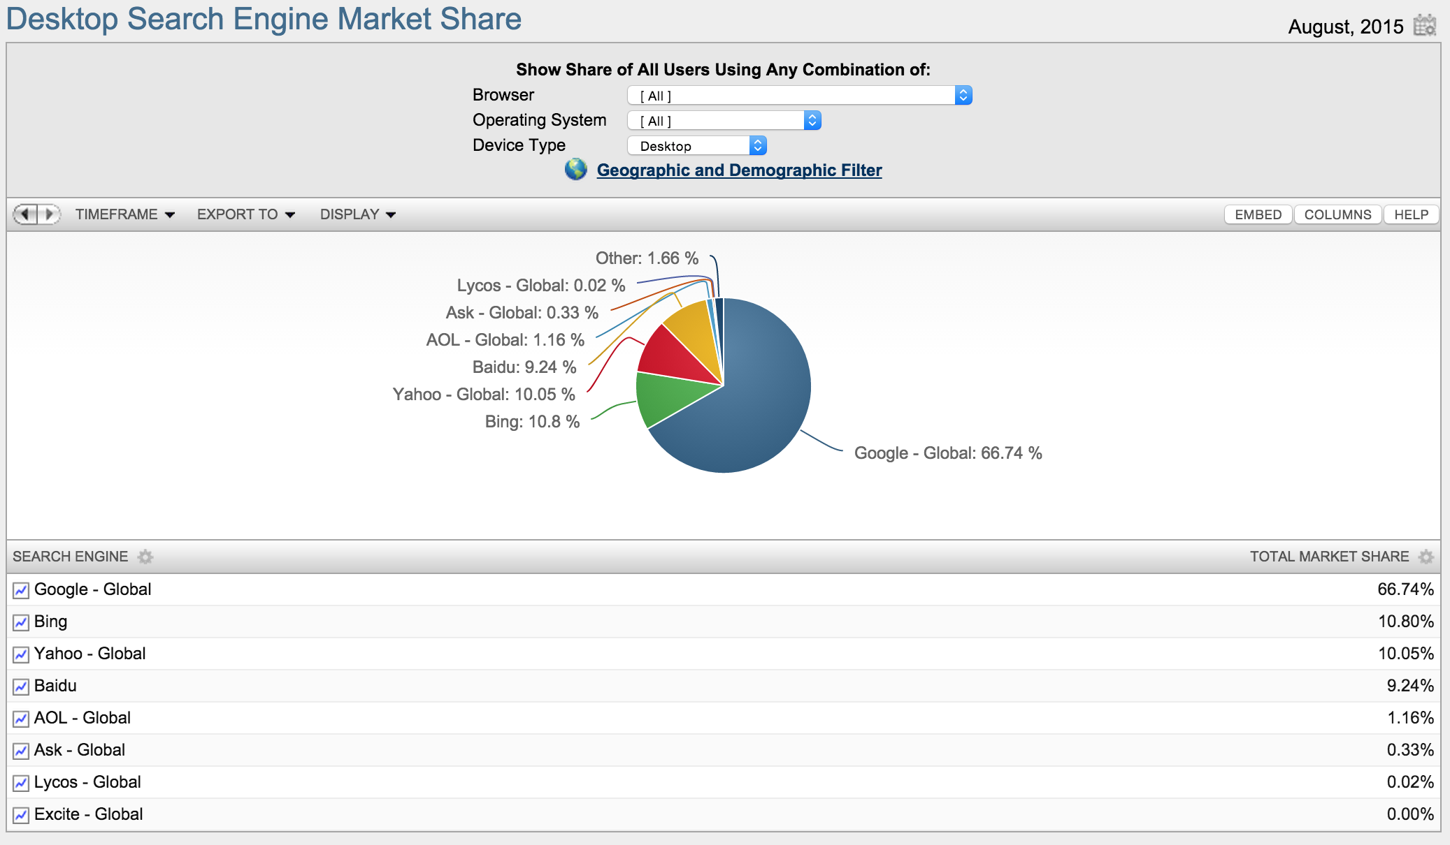
Source: http://www.netmarketshare.com/search-engine-market-share.aspx?qprid=4&qpcustomd=0

Slide 60
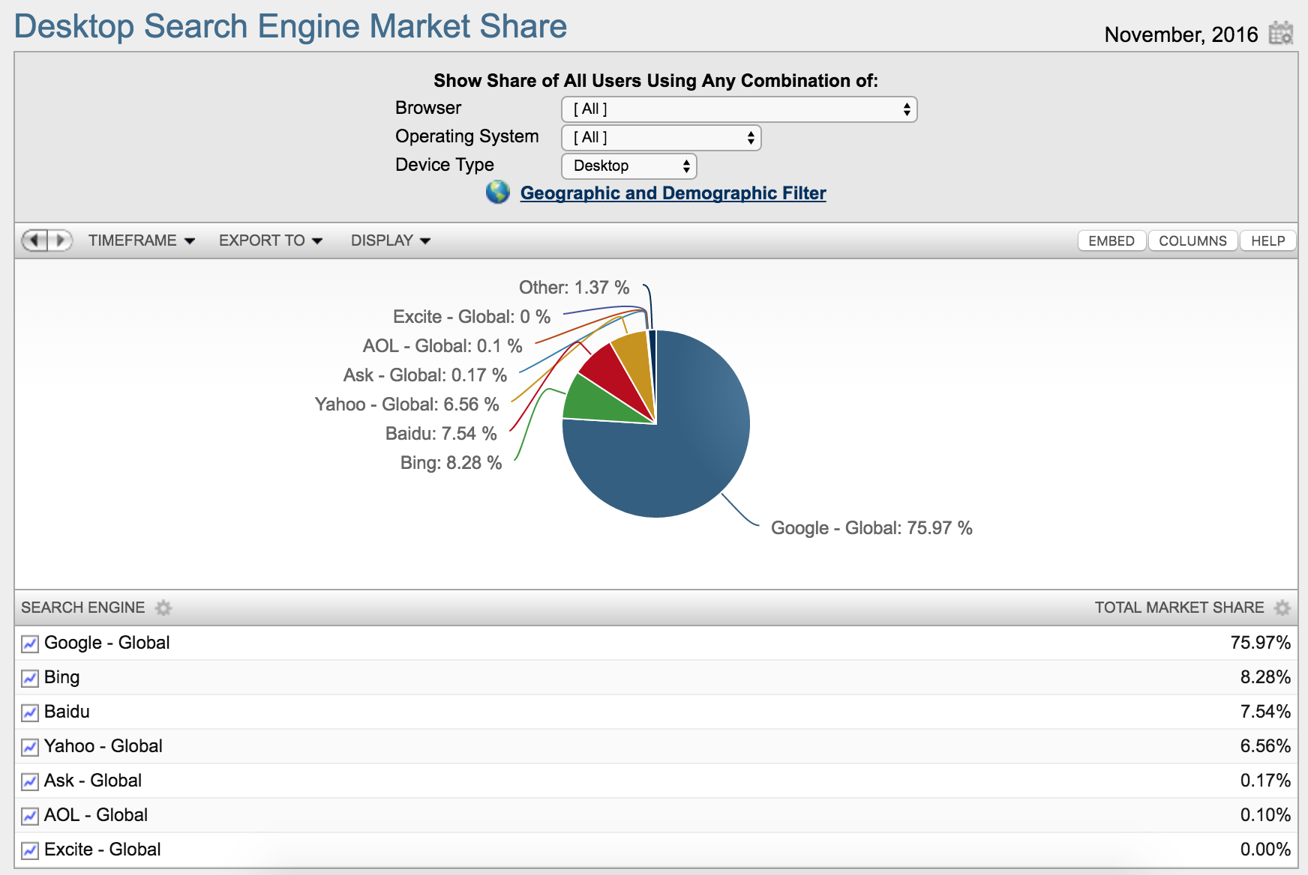
Source: http://www.netmarketshare.com/search-engine-market-share.aspx?qprid=4&qpcustomd=0

Slide 61
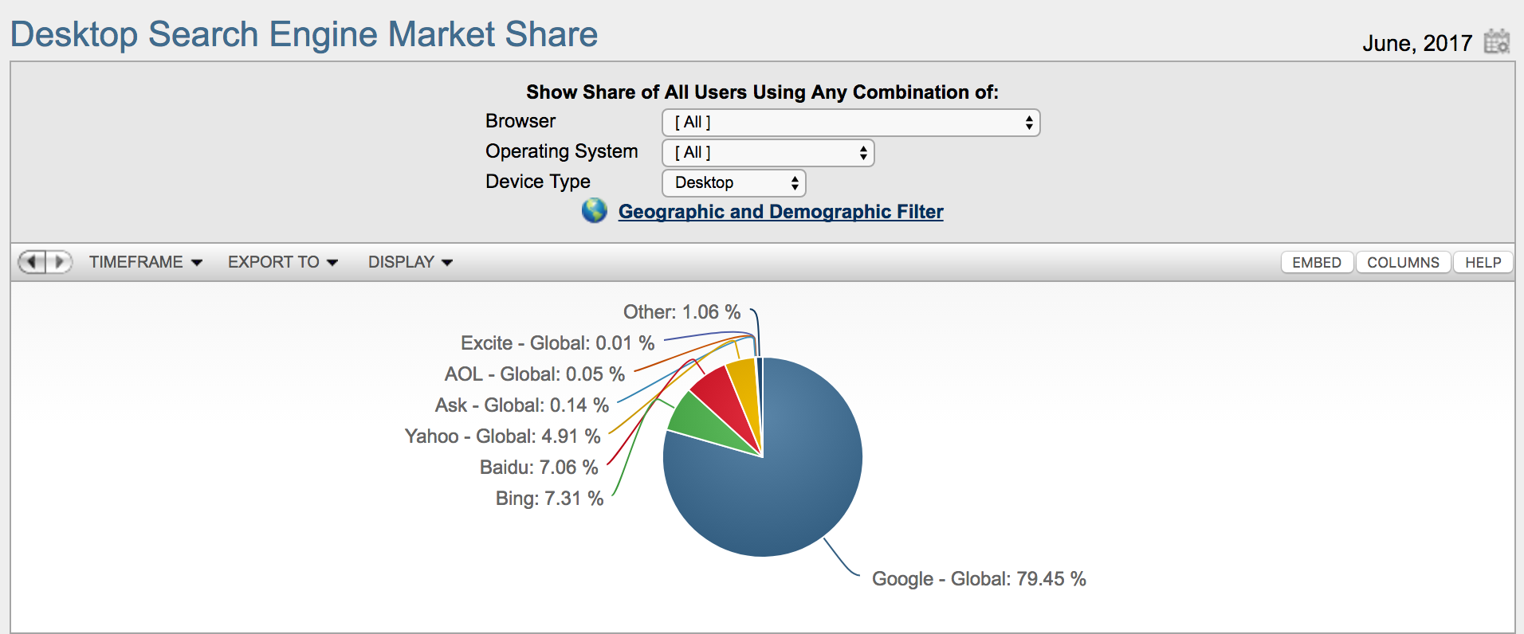
Source: http://www.netmarketshare.com/search-engine-market-share.aspx?qprid=4&qpcustomd=0

Slide 62
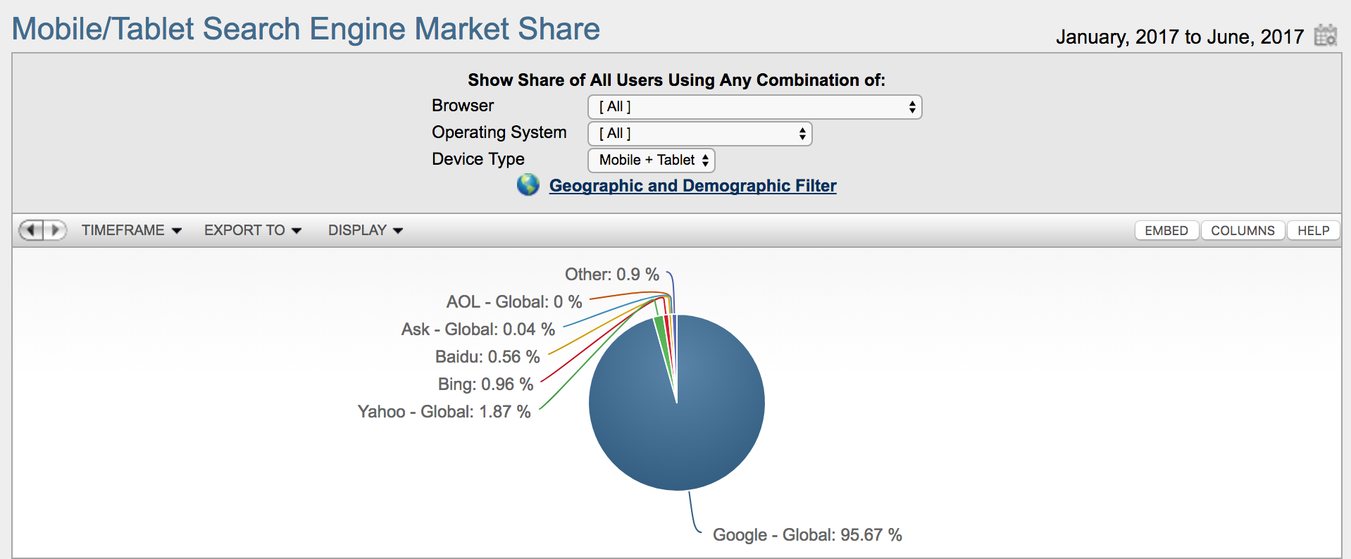
Source: http://www.netmarketshare.com/search-engine-market-share.aspx?qprid=4&qpcustomd=1&qpsp=2017&qpnp=1&qptimeframe=Y

Slide 63
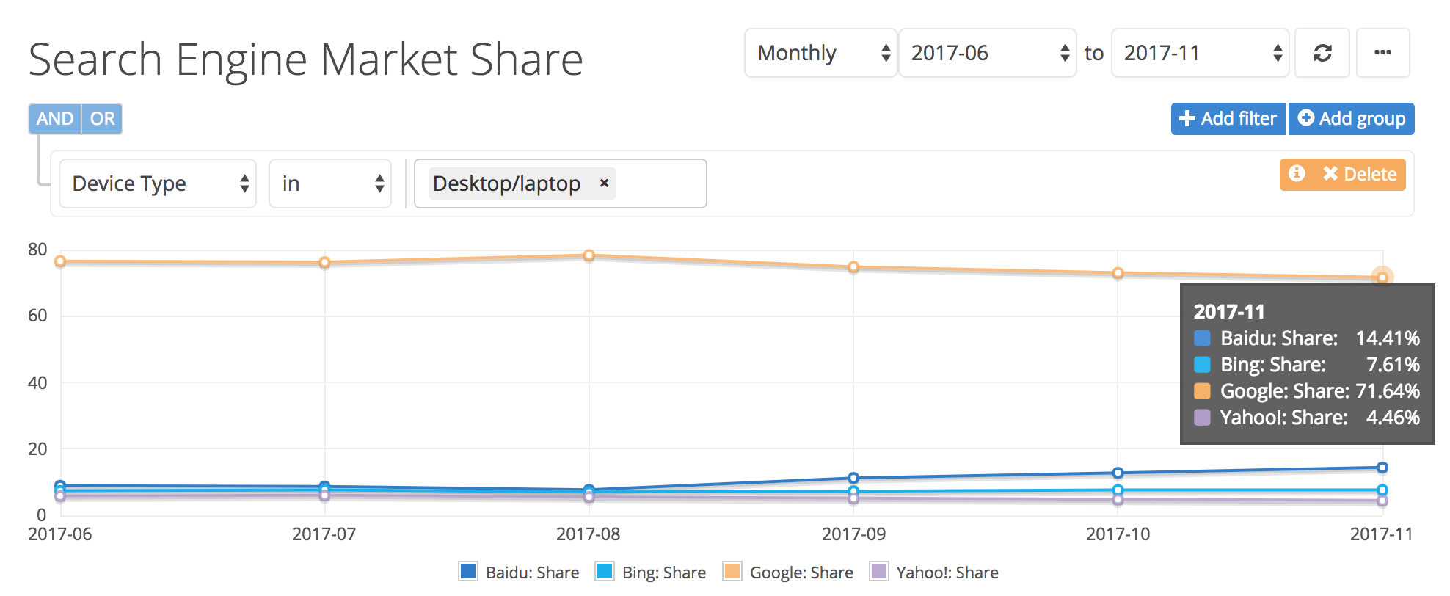
Source: http://www.netmarketshare.com/search-engine-market-share.aspx?qprid=4&qpcustomd=1&qpsp=2017&qpnp=1&qptimeframe=Y

Slide 64
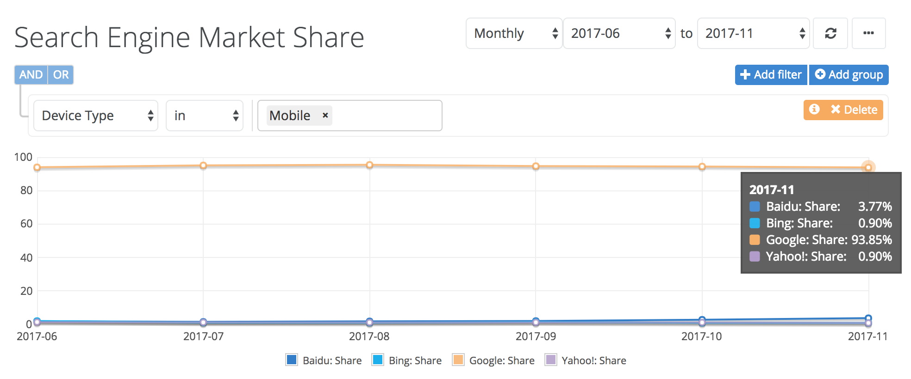
Source: http://www.netmarketshare.com/search-engine-market-share.aspx?qprid=4&qpcustomd=1&qpsp=2017&qpnp=1&qptimeframe=Y

Slide 65
What’s the Difference between Organic Search Listings and Paid Search Listings?
Free or Organic listings
Really “FREE”?
Ads =
Sponsored
Paid listings
Pay-per-click (PPC)
Cost per click (CPC)
AdWords
Paid search
Notes:
Talk about the SEO requiring someone who know what they are doing to be able to optimize a site, so there is usually a cost involved to optimize a site.

Slide 66
What are the benefits of being listed well on a search engine?
People are looking for you online: they are looking on search engines.
24/7 anytime, anywhere
Cost effective
Passive marketing

Slide 67
What Are Your Goals?
Get Traffic
Increase Awareness
Sell
your product
your services
your brand
Generate leads

Slide 68
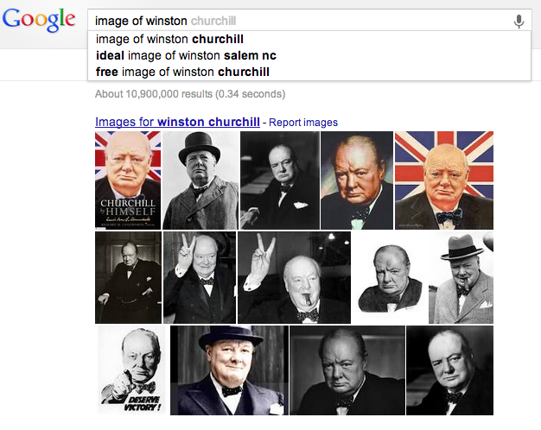
Your Search Engines Plan
“Failing to plan, is planning to fail.”
- Winston Churchill
Notes:
Find out who said that.

Slide 69
Plan for Sucess
Understand where you are in the market
Do competitor research on search engines and on their sites
Use your common sense with regards to why they are performing better or worse
http://www.similarweb.com or http://raventools.com
http://seoquake.com
http://opensiteexplorer.org
Grade your site http://marketing.grader.com/?s=wsg

Slide 70
Plan for Sucess
Understand where you are in the market
RankChecker from http://SEOBook.com (a Firefox plugin)
moz.org Opensite Explorer http://www.opensiteexplorer.org
Google Webmaster Tools http://google.com/webmasters
Google AdWords Keyword Tool http://adwords.google.com
Also try http://ubersuggest.org/

Slide 71
Plan for Success
Build your keyword list
What can you learn from your competitors and how?
Google’s Keyword Suggestion tool
Wordtracker is a fee based service, but you can try it for free here
KeywordDiscovery is another service for a fee, but you can try it out to see if you like it
Moz
Who’s your friend?

Slide 72
Plan for Success
Check for problems
Screaming Frog SEO Spider (http://screamingfrog.co.uk/seo-spider )
http://Moz.com
Google Webmaster Tools (http://google.com/webmasters )

Slide 73
Plan for Success: Value your content
Content is Queen
Nothing beats good content
Offer value, value means return visits
Be real, be generous, be valuable

Slide 74
Plan for Success
Courage with Code
Code need not be scary
Ask your webmaster
Do It Yourself
Hire a Consultant
Basics to know
Title Tag
Meta Data
Hyperlinks
Heading tags
Alt text
Social Icons and Links

Slide 75
Plan for Success
Platform Selection
Choose a platform that allows for SEO
WordPress (Yoast SEO Plugin) Note: You may still need professional help even with Yoast, but it’s a great help.

Slide 76
Plan for Success: Ask for links
Link Love
Know your link popularity and how you stack up against your competition
Link to other valuable content
Ask other websites to link to you
Make sure social sites are linking

Slide 77
z

Slide 78
Plan for Success: Create and Submit Articles
Articles
Build Content
Create Opportunities to earn links
Build Credibility
http://www.articlesbase.com/
Find others (hint search, look at email newsletter content)

Slide 79
Plan for Success: Submit your site
Submitting Your Site
http://www.google.com/submityourcontent/index.html [only do this once] or http://www.google.com/webmasters/tools/ [FREE]
http://search.yahoo.com/info/submit.html
http://www.dmoz.org/add.html [FREE]
http://www.zoominfo.com [FREE]
http://www.bing.com/docs/submit.aspx [FREE]
Notes:
Check on Bing link.

Slide 80
Remember: Where is your content hub?
What is content marketing?
How many people have a blog?
Why should we have a blog?

Slide 81
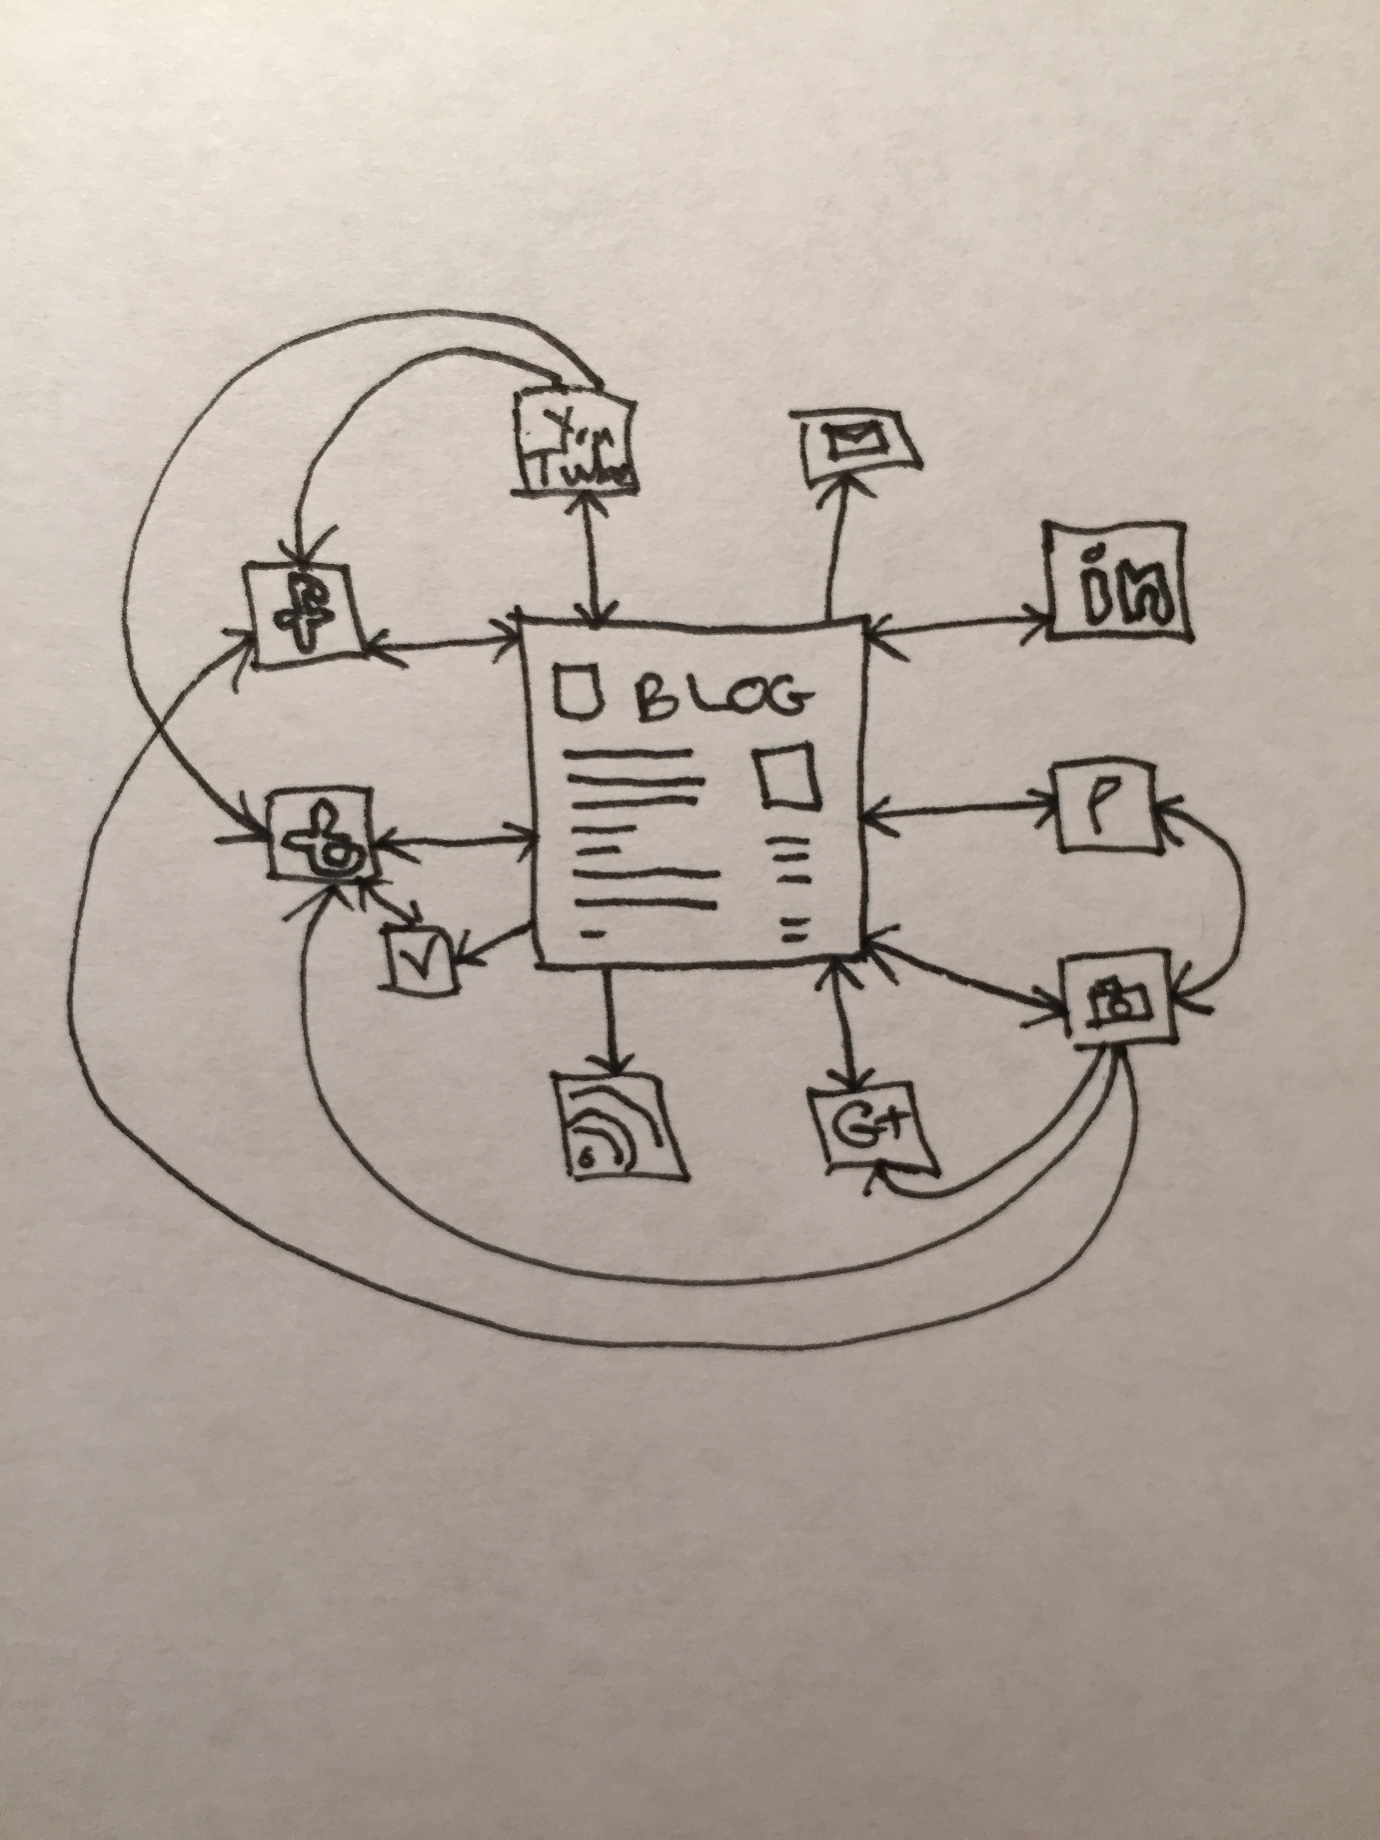
Remember: Where is your content hub?

Slide 82
Blogging
Long tail and short tail
Content marketing
Guest posting
Commenting
Notes:
Talk about the value of having a blog from a long tail search perspective. More content enables more possibilities for search rankings.
Talk about content marketing and how it is important to build content in order to be seen as an authority as well as to have fresh content for search engines to index.
Talk about the pros and cons of guest posting. It can be useful for

Slide 83
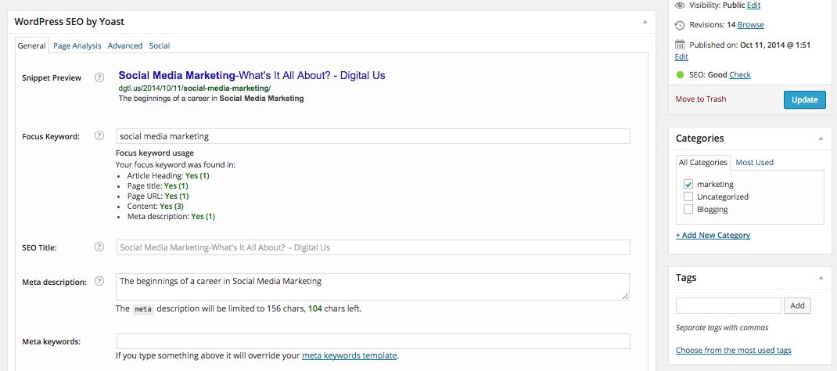
The WordPress SEO Plugin
Notes:
Go through the site and how them how to optimize a blogpost by using the WordPress SEO plugin.

Slide 84
Homework Reading
https://moz.com/blog/creating-right-marketing-mix-whiteboard-friday
http://www.thesaleslion.com/forgetting-labels-crazy-journey-pool-guy-web-app-developer/
http://contentmarketinginstitute.com/2014/02/optimize-social-media-content-combat-content-shock/
http://susby.com/marketing/search-engine-marketing-checklist/

Slide 85
Homework
Class 1: Homework
Watch The Power of Three: Content Marketing + SEO + Social Media by Krista LaRiverie on YouTube: http://www.youtube.com/watch?v=1v7PVF4g7Nk
What is “the keyword gap”?
Watch https://www.youtube.com/watch?v=g8UwJcWimW8
Watch https://youtu.be/x33m6CS-cic
Read articles on previous slide.
Write a blogpost on something related to digital marketing on http://dgtl.us Remember to use relevant keywords.

Slide 86
Homework
Class 2: Homework
Share your post and/or other posts from http://dgtl.us on social media and comment on any posts that interest you.
Watch all videos about AdWords here: https://support.google.com/adwords/answer/4362159?hl=en&ref_topic=3381144
Answer the following questions:
What is the best keyword for your site? How did you determine this?
Provide 5 other keywords you think would be good to optimize for
Describe how you would optimize your site to improve rankings
Create a Google AdWords ad for your business
For in class discussion: Think about search engines on sites that are not Google, Bing, Yahoo or Ask.com. What is the value of search?

Slide 87
Class 2

Slide 88
Class 2 Agenda
Recap of Class
Analytics
SMO
Site Clinics
SEM/Paid Search
AdWords
Q&A
Review of Optimized Blog Posts
Strategy and Best Practices
Advanced Analysis and Reporting

Slide 89
Analytics
Why?
How?
What?
The following slides show videos for how to set up and/or view your Google Analytics.
Notes:
Why do we look at Analytics?

Slide 90
How to Add Google Analytics to Your Wordpress.org Blog

Slide 91
How to Add Google Analytics to Your Wordpress.org Blog [part 2]

Slide 92
SEM
Google AdWords
Other Paid Search
Notes:
Site clinic

Slide 94
Paid Search
PPC, CPC, Sponsored Listings
Google AdWords - http://adwords.google.com
Bing Ads – https://ads.bing.com

Slide 95
Paid Search
Google
AdWords and AdSense:
What’s the difference?

Slide 96
Paid Search
Google Match Types
Broad match
Phrase match
Exact match
Negative keywords

Slide 97
Paid Search
Google
Broad match: dark chocolate The dark and dreamy chocolate
Phrase match: “dark chocolate” The dark chocolate was dreamy
Exact match: [dark chocolate] Dark chocolate
Negative keywords: -milk, -white, -truffle only dark, not anything else or only chocolate not (dark)-night or (dark)-humor or -milk (chocolate)

Slide 98
Google Keyword Matching Tutorial
http://support.google.com/adwords/bin/answer.py?hl=en&answer=6100

Slide 99
Google Keyword Matching Tutorial
https://www.youtube.com/watch?v=GXADeRR7ZTE

Slide 100
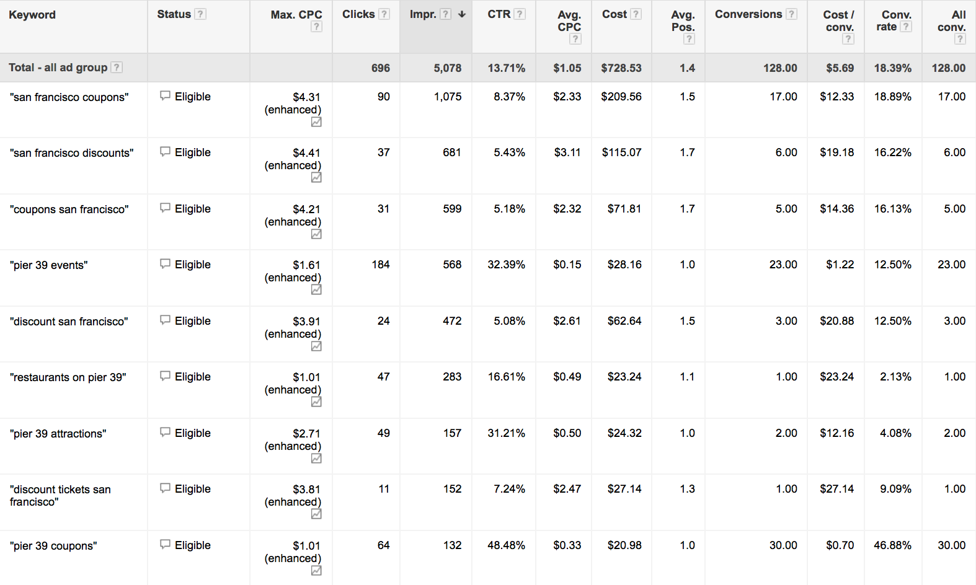
Paid Search

Slide 101
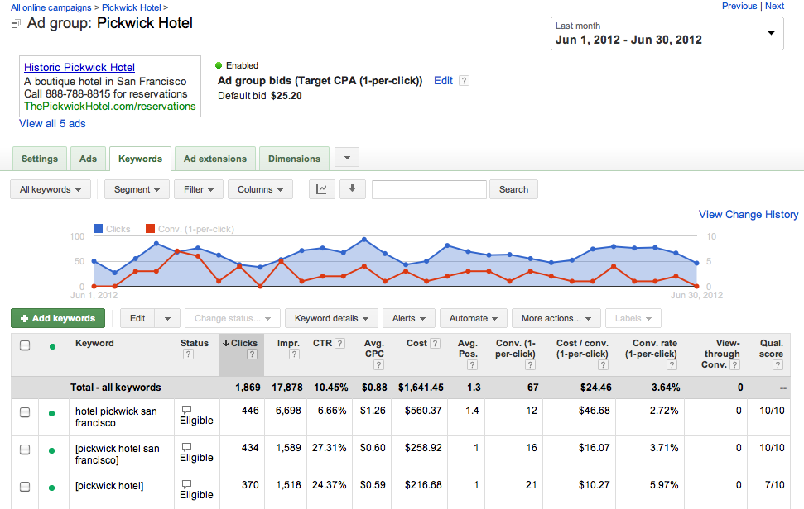
Paid Search

Slide 102
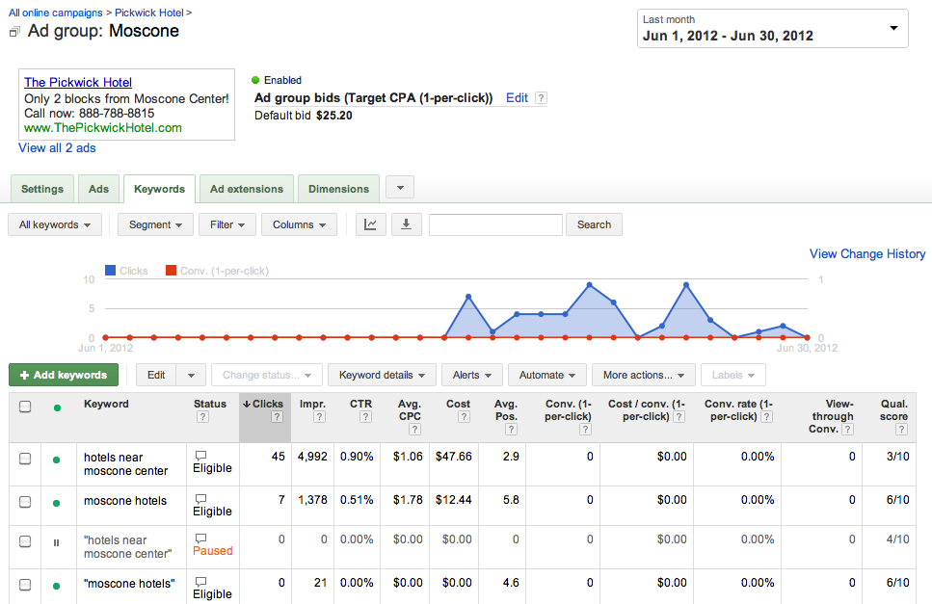
Paid Search

Slide 103
Paid Search
^{Do}
1. Create a focused list of target words
2. Identify unique aspects of your product or service
3. Remember to add keywords in your ad text
^{4. Use the appropriate URL}
^{5. create multiple ad groups}
^{6. utilize multiple campaigns}
7. use broad match, phrase match, exact match and negative keyword terms
8. optimize ad serving for your ads
^{9. track results (analytics)}
10. Modify bids on content network ads

Slide 104
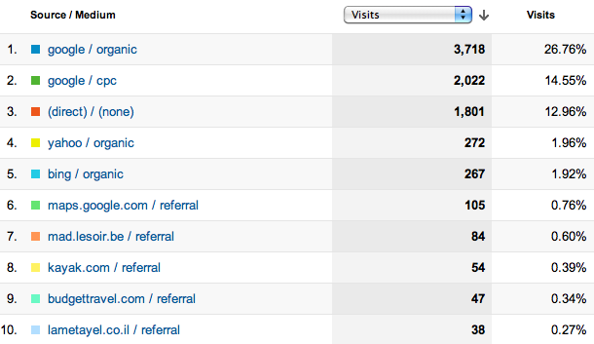
Analytics: Traffic Sources

Slide 105
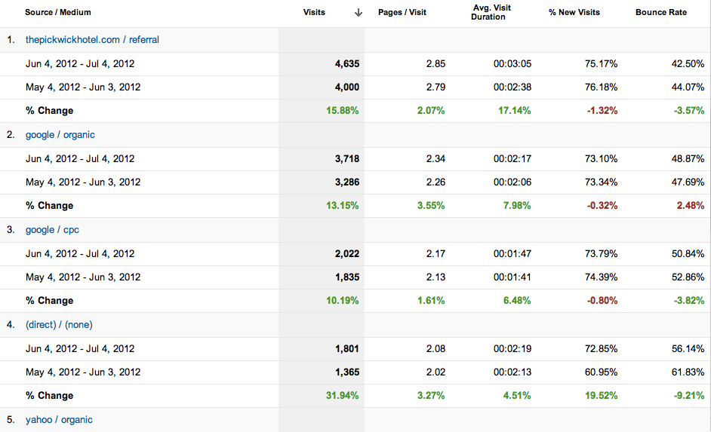
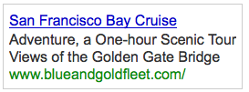
Paid Search

Slide 106
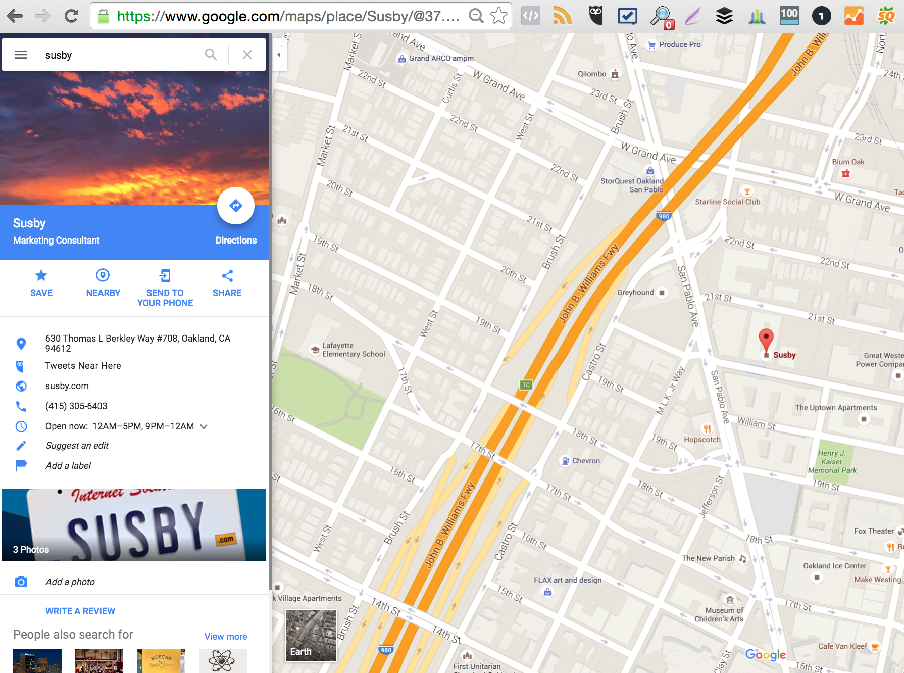
Local Search is your friend
^{Google Maps and Google+}
^{Must have a physical address}
^{Reviews are good}
^{Process}
^{Pictures}
^{Details}

Slide 107
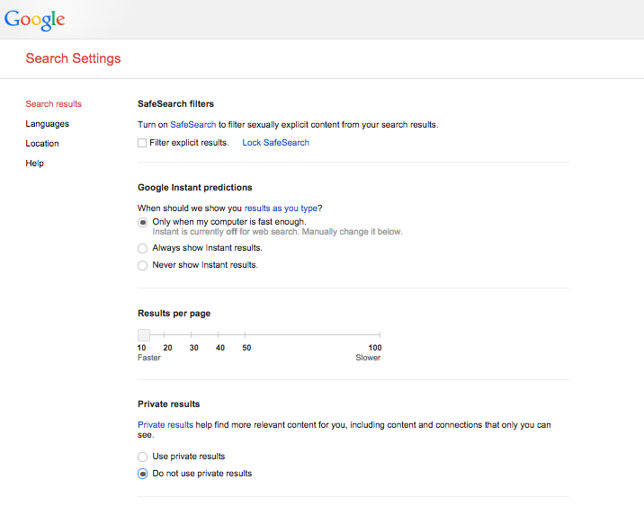

Slide 108
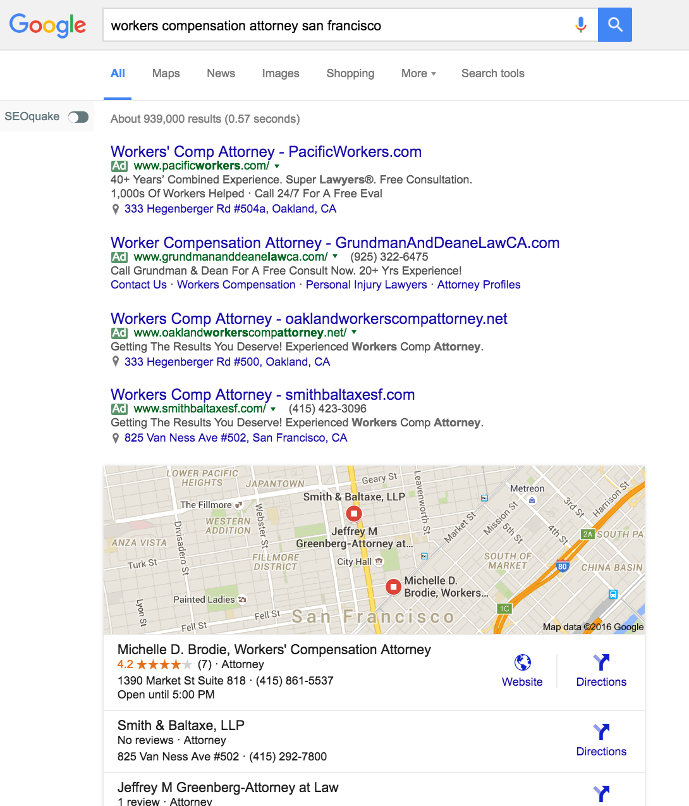
Local
Notes:
Local

Slide 109
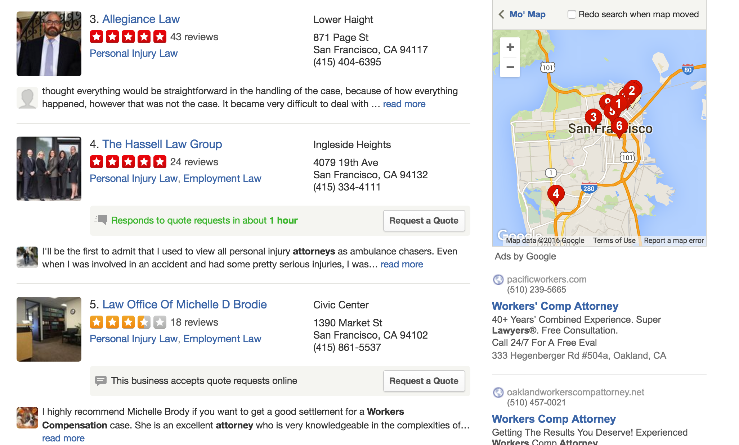
Yelp! can help

Slide 110
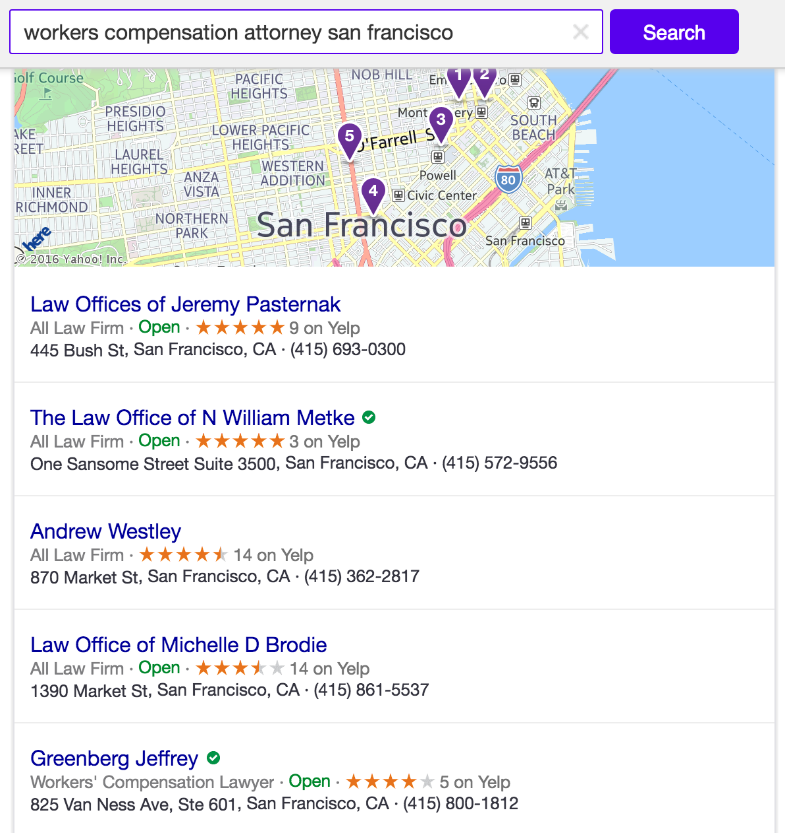
Local
Notes:
Yahoo! Notice the use of Yelp reviews on Yahoo!

Slide 111
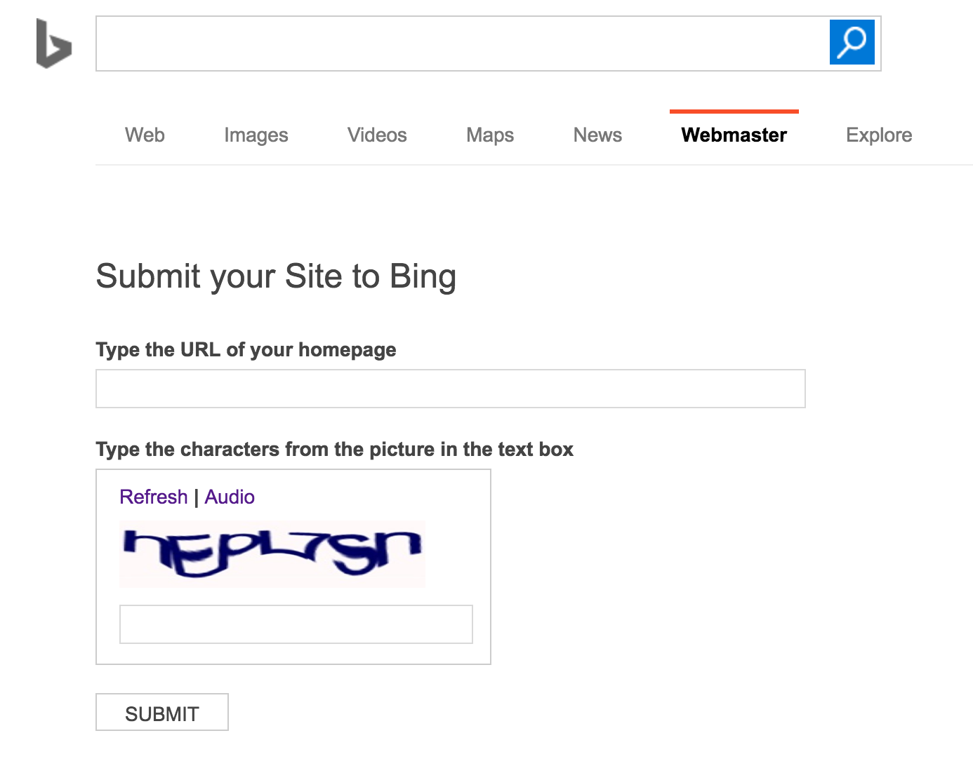
Local
^{Bing Local}
Add your local business to Bing Local:
http://www.bing.com/toolbox/submit-site-url

Slide 112
SMO
What is SMO?
What is an SMO?
What does an SMO do?
Is there an SMO in da house?

Slide 113
REAL SMO
7 Steps To improve Your SMO
Joshua Berg is one of the leading advocates of SMO. He has promoted a seven step model REALSMO, which is:
Reputation - build your reputation as a reliable qualified source
Engagement - encourage more engagement, sharing & reciprocate
Authority - become a notable authority in your field of expertise
Leadership - harness originality & creativity, be a Thought Leader
Social - be social, find and engage sociable experts in your field
Media - know your social media platforms to maximize influence
Optimization - improve technical aspects to increase optimization

Slide 114
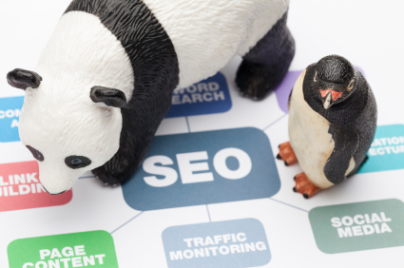
SEO and Social Media
Authority
Links
Penguin and Panda and algorithm madness!

Slide 115
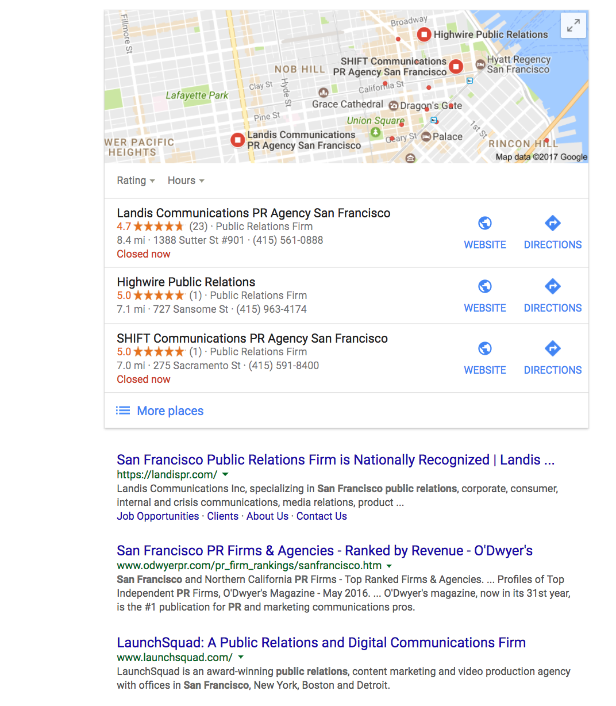

Slide 116
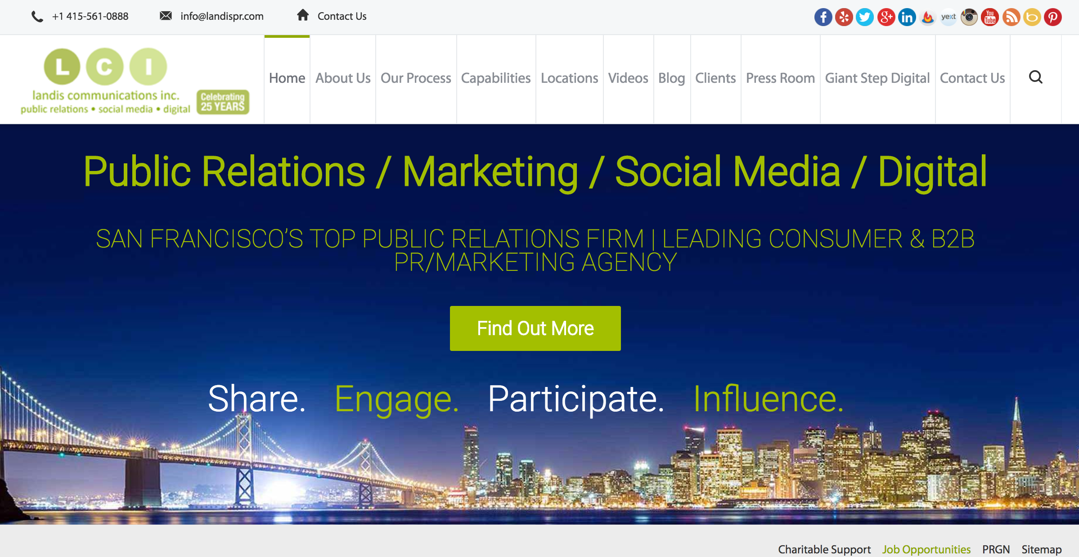
Result # 1
Notes:
Not in SF

Slide 117
Result # 1
812 likes on Facebook
2,823 followers on Twitter
Social icons make sharing easy
Many ways to connect via social
Mobile responsive
Notes:
Not in SF

Slide 118
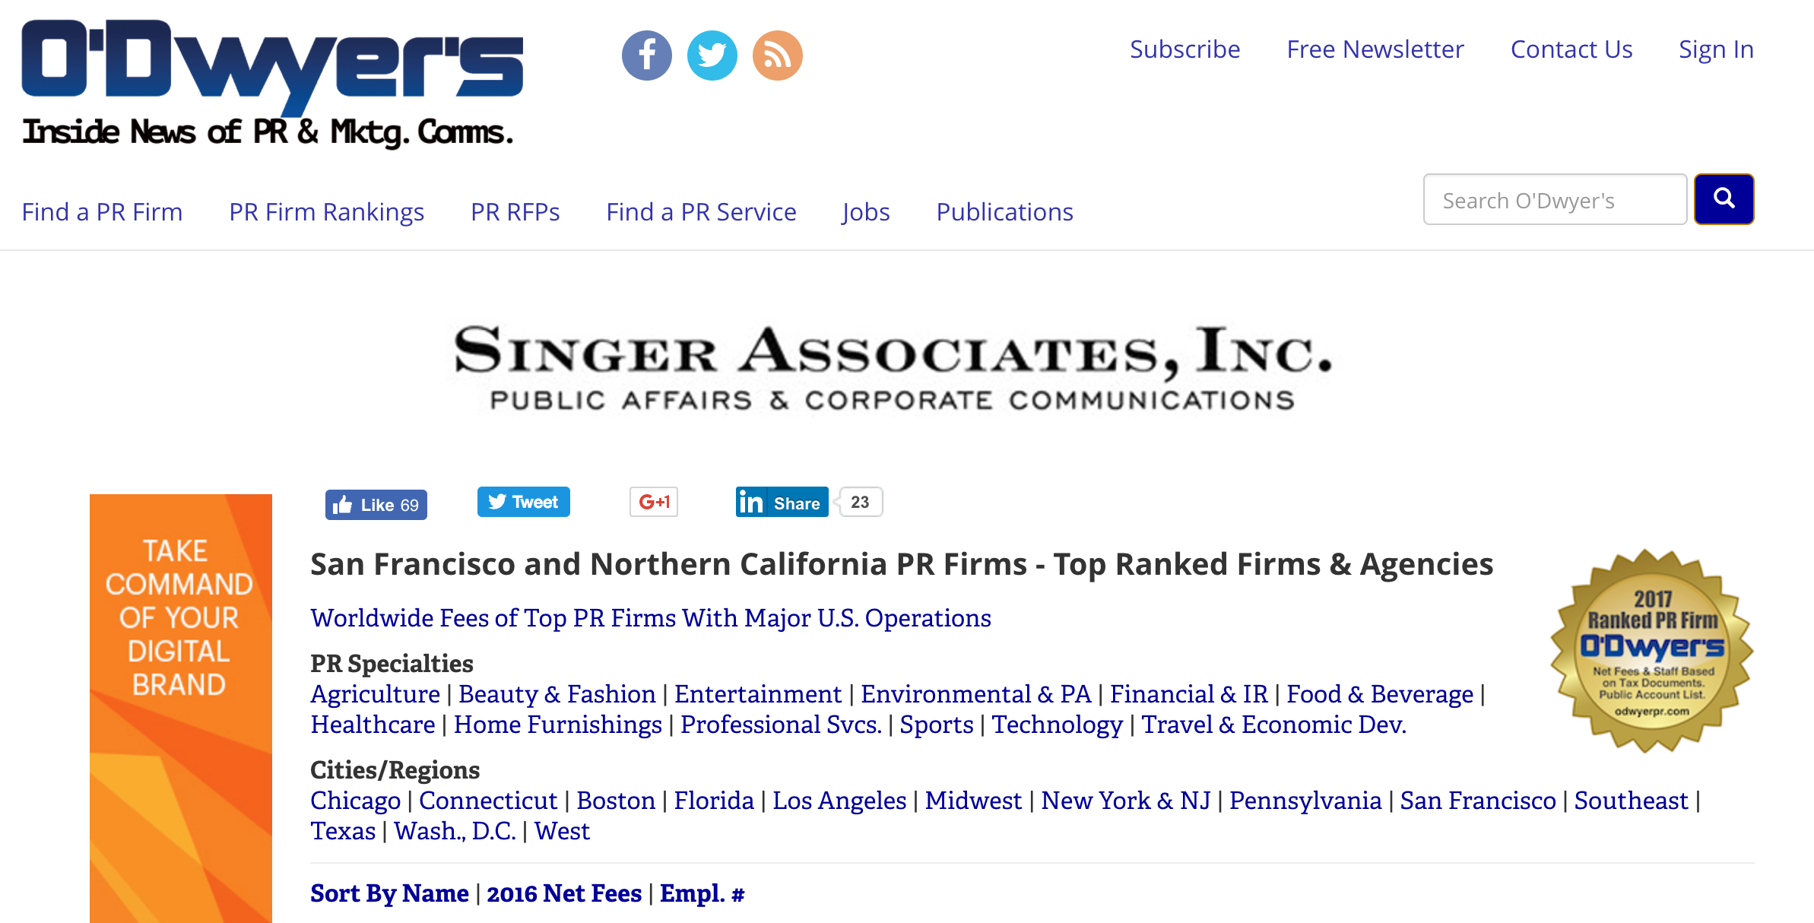
Result # 2
812 likes on Facebook
2,823 followers on Twitter
Social icons make sharing easy
Notes:
Not in SF

Slide 119
Result # 2
1,413 likes on Facebook
12,589 followers on Twitter
Just two social networks
Plus an RSS feed
812 likes on Facebook
2,823 followers on Twitter
Social icons make sharing easy
Notes:
Not in SF

Slide 120
Result # 3
Notes:
Not in SF

Slide 121
Result # 3
1,521 likes on Facebook
4,057 followers on Twitter
Several social networks
Including Instagram
Notes:
Not in SF

Slide 122
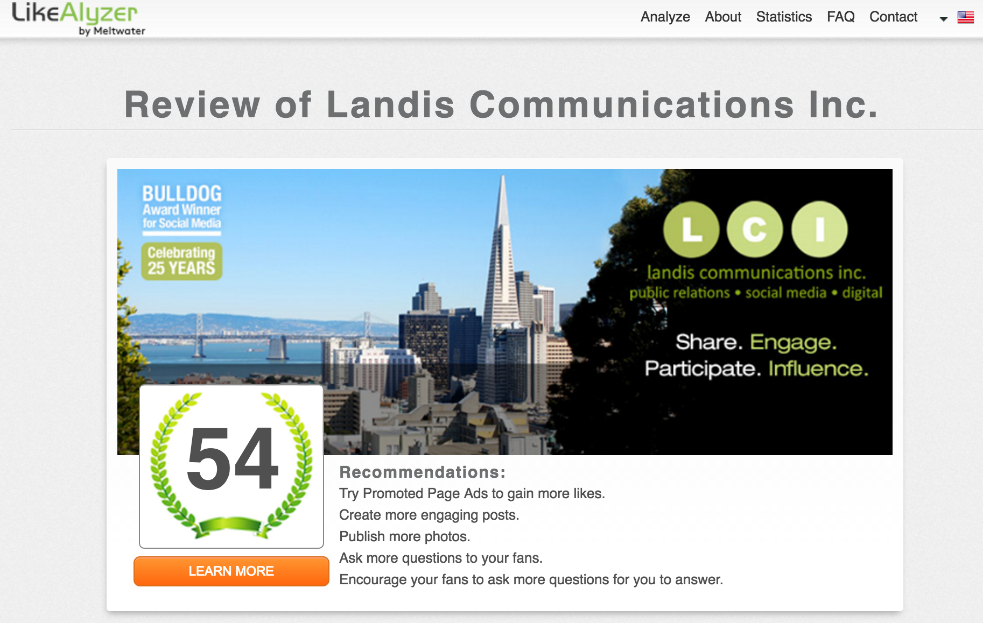
Result # 1
Notes:
Not in SF

Slide 123
Result # 2
Notes:
Not in SF

Slide 124
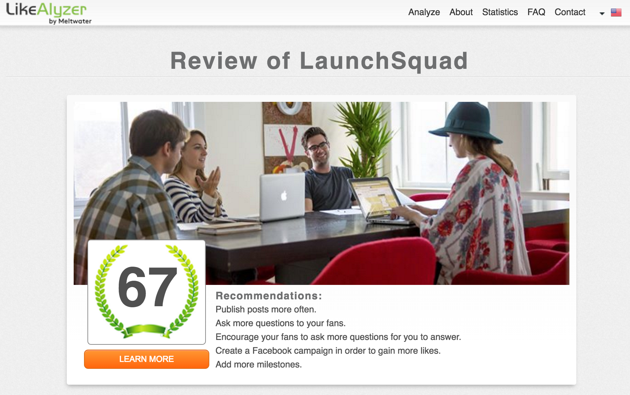
Result # 3
Notes:
Not in SF

Slide 125
Landis PR 812 likes 12 talking about 1.48% engagement rate 269 followers 2,823 followers 130 followers 280 followers | O’Dwyer’s 1,413 likes 1 talking about 0.07% engagement rate No icon 12,589 followers No icon No icon | LaunchSquad 1,521likes 5 talking about 0.33% engagement rate No icon 4,057 followers No Icon 1,009 followers

Slide 126
7. Social Media Distribution
Social sharing and social bookmarking
Help, don’t sell
c. Is it shareable?
Notes:
Site clinic

Slide 127
Plan for Success: Measure, Monitor and Monitize
Analytics
To improve you must measure
The process is ongoing
Monitor at least monthly http://analytics.google.com
View and decide based on changes in:
Number of visits
Average length of time spent
Top visited pages
Referring sites
Top keyword phrases
Search engine traffic

Slide 128
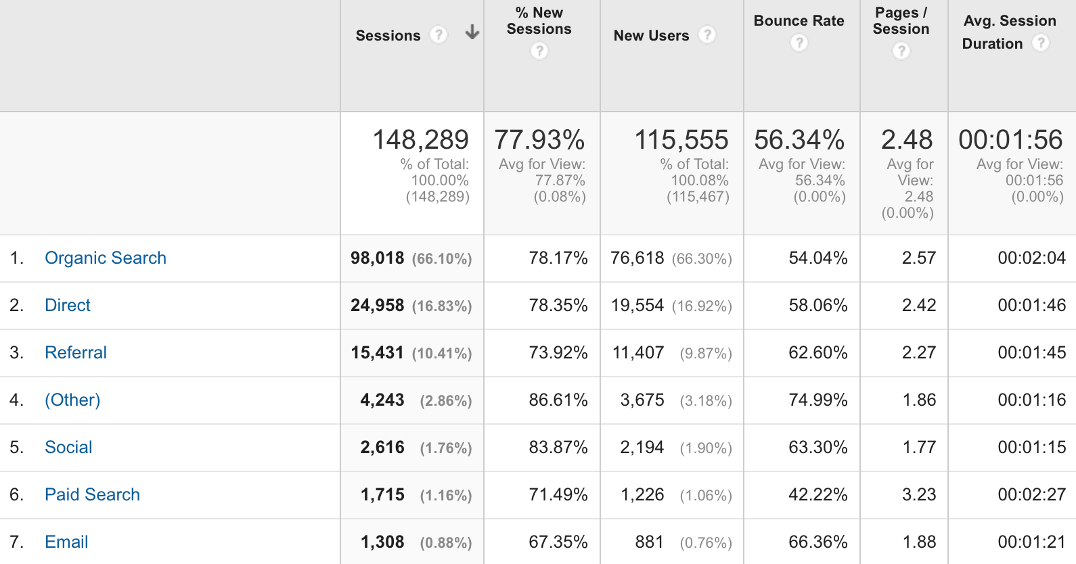
Plan for Success: Measure, Monitor and Monitize

Slide 129
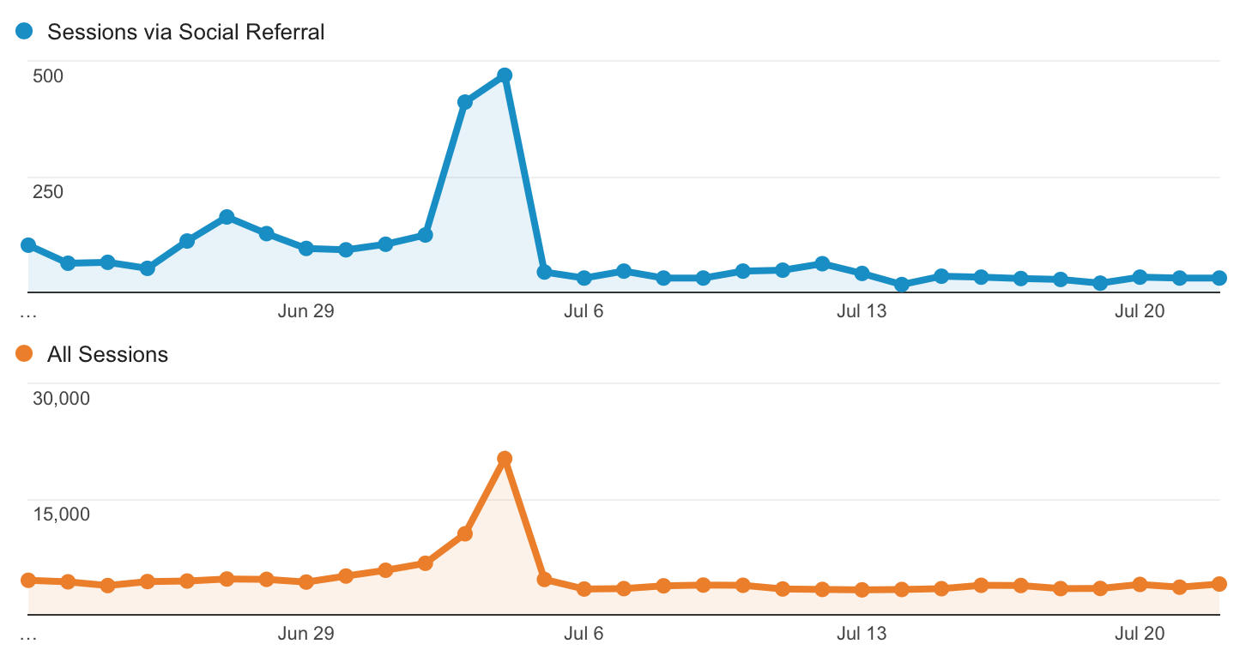
Social is just a small fraction of website traffic sources

Slide 130
Always consider Avg. Session duration and Pages/Session

Slide 132
Search and Social Checklist
1. On Site Review
Look at the website
Make note of anything that jumps out
Call to action
Headline
Images or Video
Links
Comments
Tone or Colors

Slide 133
2. Search Engine Review
Go to Google.com and enter a keyword phrase that someone might use to find your site
Follow the links to the top 4 ranked sites and try to understand why they are ranking well
View Source for more detail
Follow any social links to see how the businesses are doing in social media
Go back to your site and see if it has any of the observations you found from the highest ranking sites
Make a list of missing elements or “To improve”

Slide 134
3. Keyword Research
Figure out which keywords are best for your site to rank for
Use Google AdWords Keyword Tool (low competition, high volume)
Distill the list down to 6 keywords to focus
Figure out the ranking of your site for 6 keyword phrases
RankChecker Plugin Tool on Firefox
Manually
SeoMoz (trial)
Google Chrome Extension
Make a spreadsheet or note current rankings for benchmarking purposes

Slide 135
4. Optimize
Start optimizing
Title tag
Meta description
Content
Alt tags on images
Include an image
External links

Slide 136
5. Analyze
Run your page through a page analyzer
http://marketinggrader.com
Moz Opensite Explorer - http://www.opensiteexplorer.org/
SEOQuake – http://www.seoquake.com
http://smo.knowem.com/
Fix any other issues found through the analyzer if/as appropriate
6. Monitor
Start monitoring weekly
Monitor top ranking competitors against your own site

Slide 137
7. Content Marketing
Build your content marketing calendar and follow it
Include each social network that makes sense for reaching your target audience
Blog (your hub)
Facebook
Twitter
YouTube
LinkedIn
Google Plus
Email
Others – Instagram, Tumblr, Yelp, Flickr, Snapchat, Pokemon Go?
Schedule time to respond to tweets and social media interactions in real time
Schedule real life interactions

Slide 138
8. Track your marketing reach

Slide 139
8. Tools
Analysis Tools
http://marketinggrader.com
Moz Opensite Explorer - http://www.opensiteexplorer.org/
http://smo.knowem.com/
https://adwords.google.com/ko/KeywordPlanner/Home - you’ll need a Google Account for this
http://analytics.google.com
http://www.ahrefs.com
http://google.com/webmasters
SEO Software and Education
http://www.magesticseo.com
http://www.raventools.com
http://seomoz.org
http://www.marketmotive.com
http://www.seoquake.com

Slide 140
9. Strategy and Best Practices
Strategy:
The Power of 3: SEO + SMO + Content
Think REALSMO
Think Content is King and Frequency is Queen
Think Relevance and Quality

Slide 141
Strategy and Best Practices
Best Practices:
Practice White Hat SEO
Provide excellent content
Make sure content is easily shareable
Participate in the social spheres
Monitor regularly
Remember your friend ;)

Slide 142
10. Summary and Next Steps
Summary
SEO no longer exists in a silo, it is connected to all other content marketing
It’s not enough to just have a website, your site much be findable and offer ways for people to share your content
Consistent monitoring will help you stay on top of a constantly changing industry
Practicing white hat SEO is the best long term strategy

Slide 143
Summary and Next Steps
Next Steps
This is just the beginning, remember who your friend is! ;)
SEO, SMO and content marketing is continuous work and all are always evolving
Stay current by reading, listening to podcasts, watching how to videos, participating on industry forums and staying inquisitive
Attend Search Marketing and Social Marketing conferences as much as you can afford to
Keep in touch with me and your fellow cohorts

Slide 144
Remember
Search engines change their algorithms constantly, so the best way to ensure long term good rankings is to build great content that is worth sharing.
Content that is shareable wins.

Slide 145
More Resources
6 Social Media Best Practices That Boost SEO - http://www.forbes.com/sites/jaysondemers/2015/01/27/6-social-media-practices-that-boost-seo/#7b78c2812720
Search Engine Land’s Guide to SEO – http://searchengineland.com/guide/seo
Moz Beginner’s Guide to SEO – https://moz.com/beginners-guide-to-seo
How to Optimize for Google’s Featured Snippets – https://searchenginewatch.com/2017/06/15/how-to-optimize-for-googles-featured-snippets/

Slide 146
Case Studies / Hands On Workshop
Volunteer your site for review

Slide 147
Q&A

Slide 148
Thank You!
Please keep in touch
Suse@susby.com
http://www.susby.com
http://www.linkedin.com/in/susanbarnes
http://www.twitter.com/susby
http://www.facebook.com/susbyDigital
http://www.instagram.com/susby
http://www.google.com/profiles/susan.barnes

